Slide 1
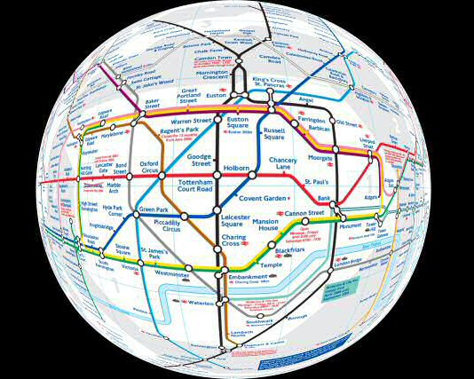
4th International Evidence Based Policing Conference
5 July 2011
London Underground Crime Data (2009-2011)
&
Operation “BTP-LU-RCT”
Barak Ariel & Lawrence Sherman

Slide 2
79,694 Reported Incidents / 40,484 Crimes
2-year + Period 01/01/2009 – 28/02/2011
Across London Underground
Hot Times
Hot Stations
Hot Lines
Hot Platforms
Big Questions:
Time and Space concentrations of crime

Slide 4
Concentration of Crime in Time

Slide 5
N in 2009 = 19,639 N in 2010 = 17,937

Slide 7
25% of time (6 hrs) accounts for over 45% of all crimes per day

Slide 8
Day of the Week X Hour of Day
12 hours in these 4 days account for 26.2% of all LU crime

Slide 9
Concentration of Crime in Space

Slide 11
Crimes in Stations but NOT on Trains 2010
33 Stations (out of 334) produce 50% of all hard crimes* in London Underground
* violence, sexual assaults, drugs, criminal damage, robbery, public disorder

Slide 12
Crimes On Trains only (2010)
Line | -7AM | 7-10AM | 10-4PM | 4-7PM | 7-10PM | 10PM+ | Total
Central | 62 | 141 | 156 | 288 | 197 | 121 | 965
Piccadilly | 45 | 68 | 156 | 234 | 159 | 88 | 750
Circle | 19 | 95 | 146 | 210 | 135 | 79 | 684
Jubilee | 36 | 101 | 99 | 140 | 107 | 91 | 574
District | 62 | 62 | 101 | 123 | 95 | 89 | 532
Northern | 28 | 74 | 102 | 127 | 90 | 87 | 508
Bakerloo | 25 | 70 | 120 | 119 | 78 | 46 | 458
Victoria | 6 | 47 | 74 | 114 | 116 | 50 | 407
Metropolitan | 26 | 26 | 58 | 56 | 44 | 57 | 267
DLR | 2 | 22 | 42 | 46 | 33 | 21 | 166
Grand Total | 311 | 706 | 1054 | 1457 | 1054 | 729 | 5,311

Slide 13
Crimes on Platforms ONLY 2010
5% of platforms (n=15) produce 33% of all hard crimes

Slide 14
Top Two Places in Each Station X Line (n=15,472)
Bakerloo Line |  | 1297
8% of places | Oxford circus | 546
61% of crime | Piccadilly circus | 252
Central Line |  | 2631
4% of places | Holborn | 420
27% of crime | Bank monument complex | 277
Circle Line |  | 1939
9% of places | Kings Cross | 600
50% of crime | Liverpool street | 378
District Line |  | 1864
4% of places | Earls court | 329
28% of crime | Hammersmith district | 199
DLR |  | 553
5% of places | Poplar | 63
20% of crime | Canary wharf | 48
Jubilee Line |  | 1723
7% of places | Stratford | 397
35% of crime | Waterloo | 207
Metropolitan Line |  | 872
8% of places | Baker street | 210
36% of crime | Harrow on the hill | 102
Northern Line |  | 1436
8% of places | Euston | 185
27% of crime | Tottenham court road | 201
Piccadilly Line |  | 2103
5% of places | Green park | 374
34% of crime | Leicester square | 336
Victoria Line |  | 1054
17% of places | Northumberland park depot | 108
54% of crime | Victoria | 456

Slide 16
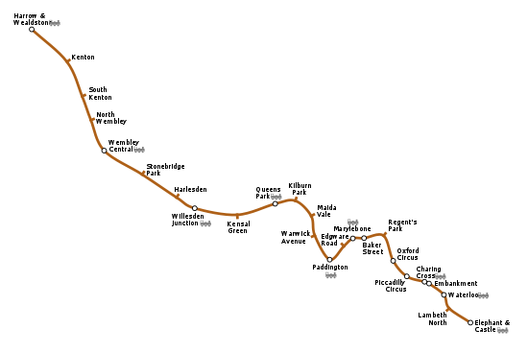
12
6
2
3
10
21
4
3
3
5
29
4
2
18
0
8
6
270
29
108
3
32
Bakerloo Line - Train & Platform crimes 2010 Data (n=588)

Slide 17
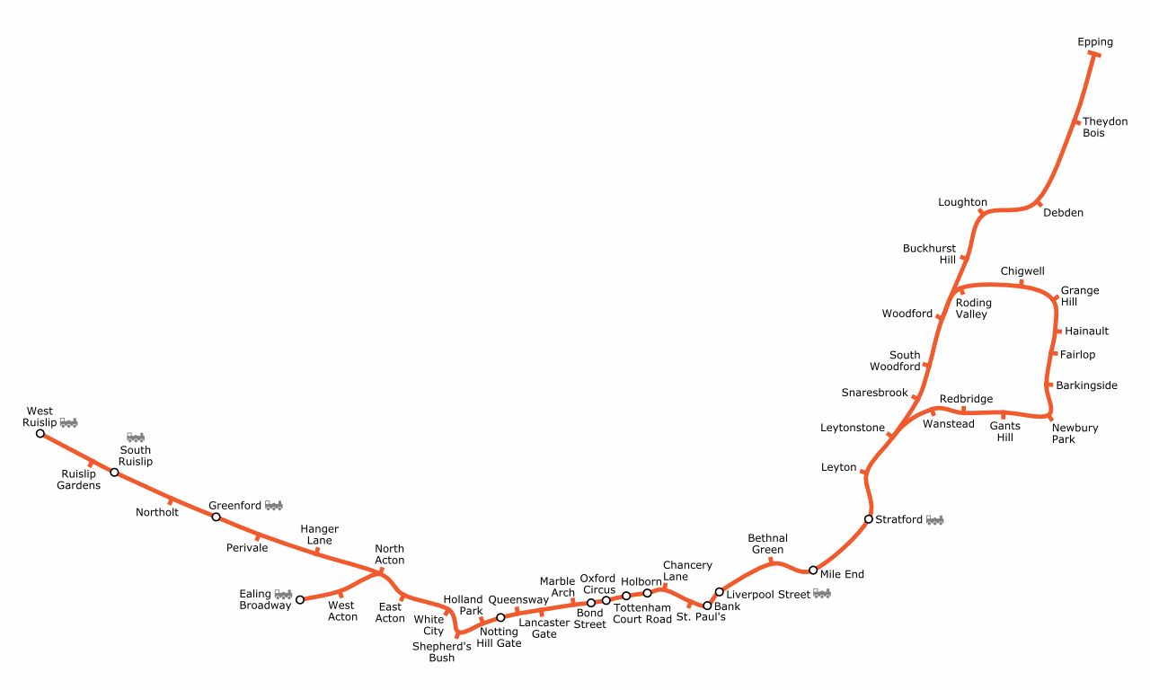
23
3
4
23
3
2
3
39
71
12
6
4
6
20
3
3
40
10
10
4
26
8
44
195
8
4
12
27
78
35
180
5
8
16
18
165
7
39
33
130
96
42
14
33
46
Central Line - Train & Platform Crimes 2010 Data (n=1195)

Slide 18
Is the LU a safe place?

Slide 19
LSOA vs. LU Stations May 2011
 |  | LSOA | 121 Random Stations (40%)
Mean # crimes (S.D.) |  | 48.8 (72.8) | 0.03 (0.04)^
Mean # population/borders |  | 1,801 | 737,663
Mean # crimes per population |  | 0.03 | 0.00^^
Size (in 10,000 square meters) |  | 32.9 | --
Crime Correlation (Pearson’s r): |  |  | 0.1 (ns)
Ratio between crimes at LSOA and Stations: |  |  | 23 : 1
^ without crimes on trains ^^ adjusted

Slide 20
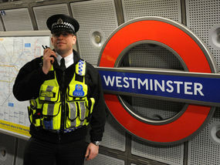
Operation BTP-LU-RCT

Slide 21
Research Hypthesis:
Police patrol in high-volume hotspots of crime in London Underground Platforms will reduce the frequency of reported crimes, compared to control conditions
Variations in Treatment:
patrol of a single police officer in hotspots
patrol of a team (2) of police officers (1 PC and 1 PCSO) in hotspots

Slide 22
Overall Design of RCT
Focus on top 150 Hot Platforms
Random allocation of patrol to treatment and control conditions:
premium service I (one officer; n=60)
premium service II (two officers; n=30)
Control group (business as usual; n=60)
Visit each experimental site for 15 Koper minutes, every 120 minutes, during hot hours, for 6 months.

Slide 23
Plan A Plan B
High Statistical Power
operationally-feasible
Select the hottest 300 LU platforms
Look at all crime types
Block Random Assignment of hot platforms to three experimental groups
A 12-months intervention period, with 24- months follow-up
Select the hottest 150 LU platforms
Define hotspots by location of hard-crimes only, in order to achieve 95% accuracy
Cluster Random Assignment of hot 4-6 platforms that are closer to one another, to three experimental groups
A 6-months intervention period, with a 12- months follow-up

Slide 24
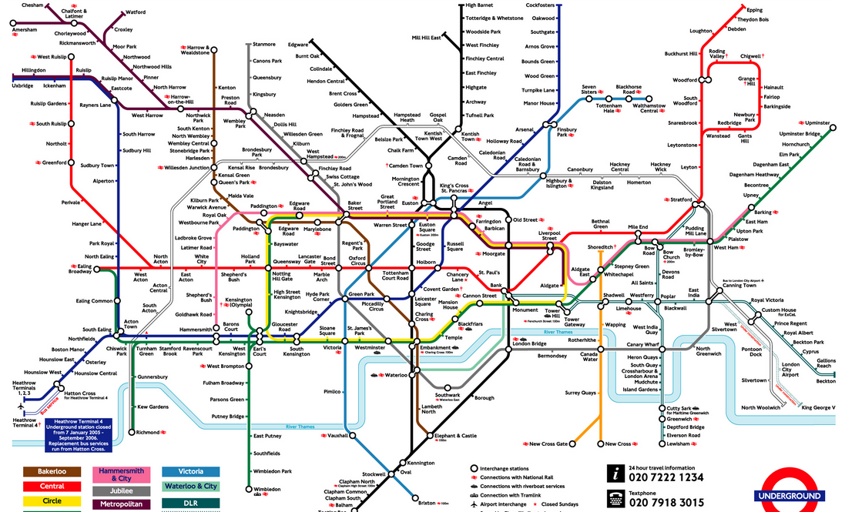
Top 60 Hotspots
Exp’t Group 1
Exp’t Group 2
Control

Slide 25
Treatments: Each patrolling unit:
Visible patrolling; proactive policing
"directed-saturation patrol"
3 experimental groups:
→ 0 officers (n=60)
→ 1 officer(n=60)
→ 2 officers (n=30)
6 Hours of patrolling during hot hours (4-10PM)
60 participating officers
15 Koper Minutes at a hotspot + 5 minutes travelling time between hotspots
Visit each hotspot receives every 120 (3 times per shift)
Every patrol unit can visit 15 hotspots per shift

Slide 26
Planned Analyses
(Before-After) number of crimes at hotspots
Diffusion of benefits / displacement to:
Catchment platforms within participating stations
Catchment stations in geographical proximity
Subgroup analyses, within distributions of
Crime volume
Passenger volume
Cost-Benefit Analyses
Longitudinal interviews of constables: power-holder legitimacy

Slide 27
4th International Evidence Based Policing Conference
5 July 2011
London Underground Crime Data (2009-2011)
&
Operation “BTP-LU-RCT”
Barak Ariel & Lawrence Sherman
ba285@cam.ac.uk

