Slide 1
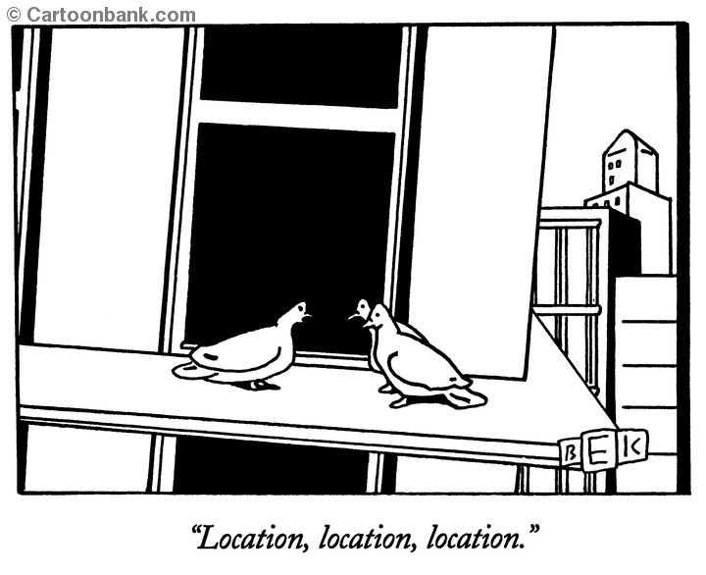

Slide 2
Coupling Crime to Place: The Promise of Place-Based Criminology
David Weisburd
Hebrew University and George Mason University
With Anthony Braga, Jim Bueermann, Shawn Bushway, Breanne Cave, Ronald Clarke, John Eck, Christine Famega, Frank Gajewski, Charlotte Gill, Elizabeth Groff, Josh Hinkle, Brian Lawton, Cynthia Lum, Lorraine Green Mazerolle, Nancy Morris, Justin Ready, Lawrence Sherman, Cody Telep, Julie Willis, Laura Wyckoff, Sue-Ming Yang and The National Institute of Justice

Slide 3
All I Ever Really Needed to Know I Learned in the 72nd Precinct (1984-1985)
Vera Institute of Justice Evaluation of a pilot program of Community Policing in NYC.
  9 Beats including between 12 and 30 square blocks per beat.
  Walked the beat with CPOs for a year.
What I learned:
  In bad neighborhoods crime was concentrated on a few streets (“small worlds,” “hot spots”).
  The police naturally focused on the hot spots, though the evaluation was focused on the beats.

Slide 4
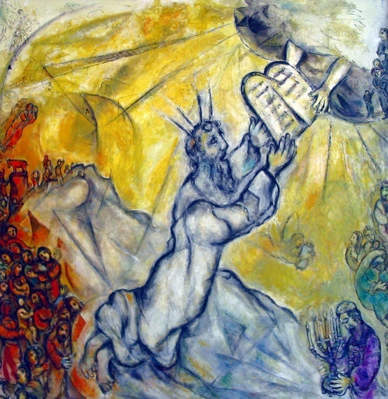
Thematic Not Chronological Order
אין מוקדם ומאוחר בתורה
  "There is not 'earlier' and 'later' in the Torah”
  Talmud Pesachim 7a

Slide 5
The Promise of Place-Based Criminology
Traditional assumptions:
  The important units of place are large units like communities or neighborhoods.
  Crime is “weakly” coupled to place. (Place is not an important “cause of crime.”)
  Crime prevention at small geographic units is not a good investment.
    The police cannot be effective in doing something about crime.
    Crime is easily moveable (“displacement”).
Our research shows:
  That the key units for place are very small micro units of geography.
  That crime is “strongly” coupled to place. (Place strongly “predicts” crime.)
  Crime prevention at places is a good investment.
    Police can be effective in preventing crime
    Crime is not easily moveable (“diffusion of crime prevention benefits”)

Slide 6

The Key Units of Analysis for Crime at Place are Very Small

Slide 7
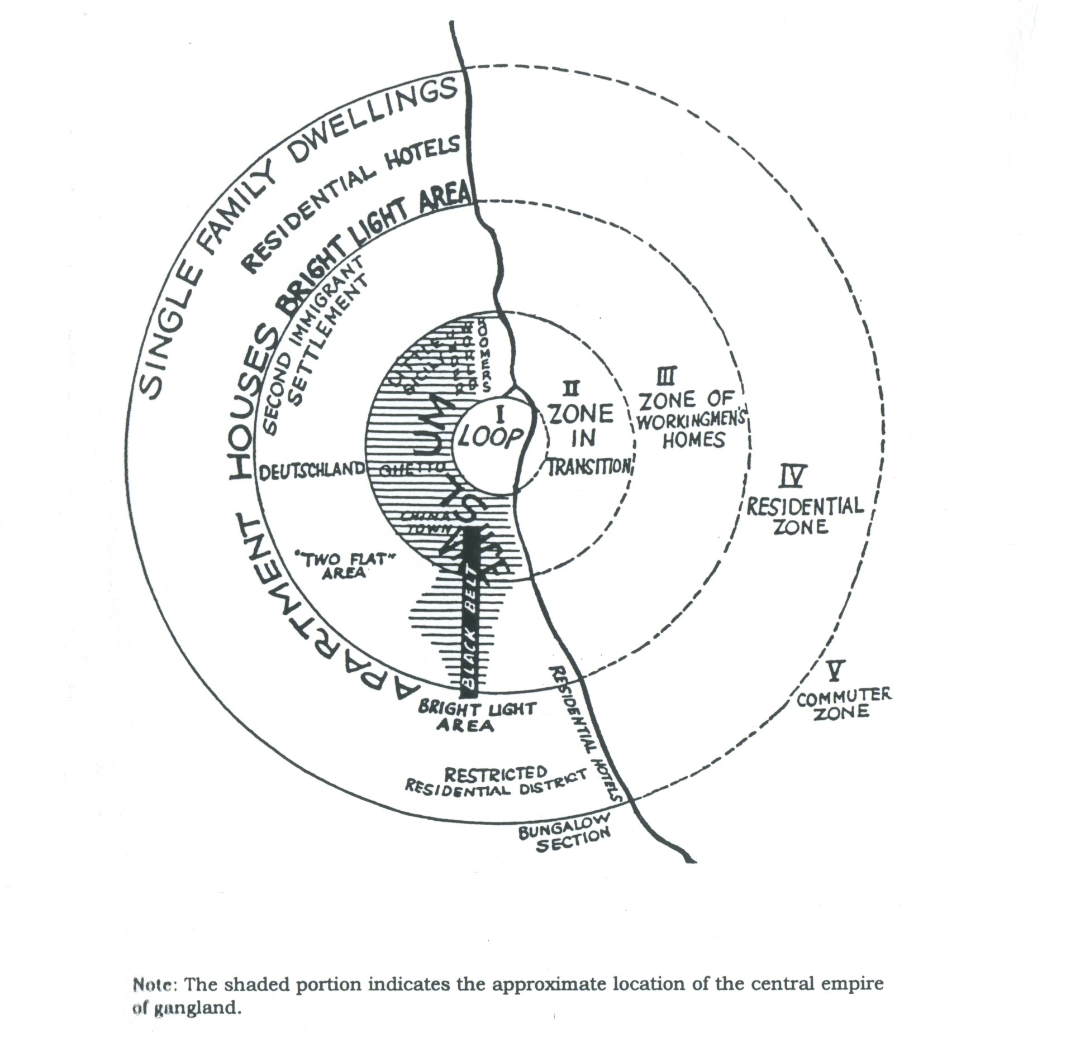
Traditional “Places” in Criminology
U. of Chicago (1920s): community-centered criminology
Focus on neighborhood dynamics.
Frederic Thrasher, The Gang (1927)

Slide 8
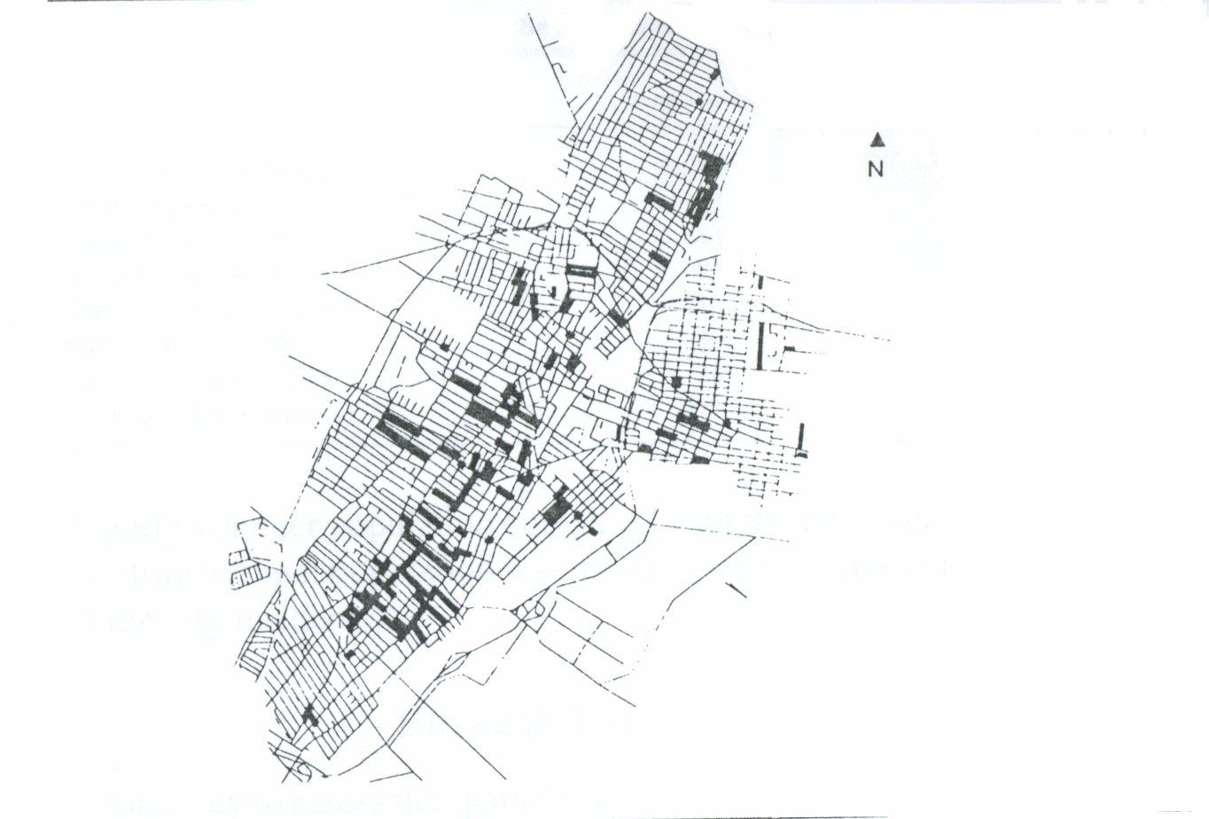
Jersey City Drug Hot Spots
Weisburd, David and Lorraine Green. (1995). Policing Drug Hot Spots: The Jersey City Drug Market Analysis Experiment. Justice Quarterly, 12(4): 711-735.

Slide 9
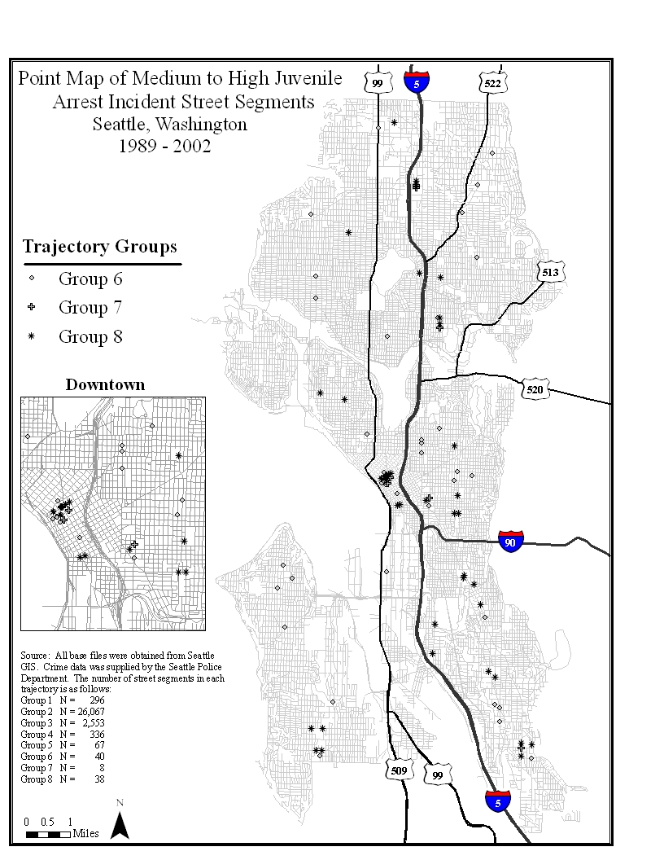
Juvenile Crime Hot Spots
Weisburd, David, Nancy Morris and Elizabeth Groff. (2009). Hot Spots of Juvenile Crime.
Journal of Quantitative Criminology , 25:443-467.

Slide 10
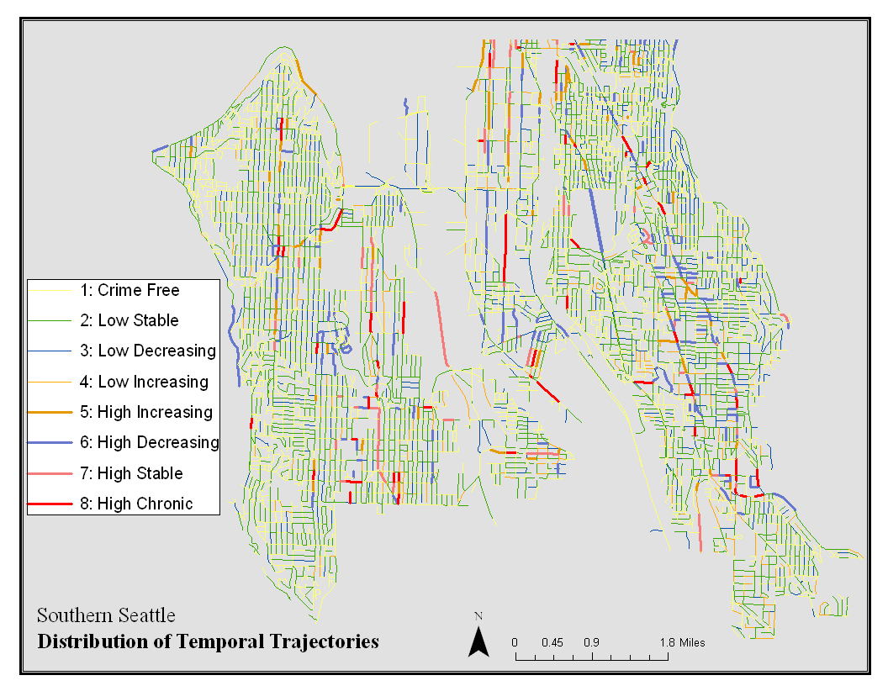
Street by Street Variability: Much of the Action of the Crime Problem Would be Lost by Studying Communities
David Weisburd, Liz Groff and Sue-Ming Yang (2010). Understanding Developmental Crime Trajectories at Places: Social Disorganization and Opportunity Perspectives at Micro Units of Geography , NIJ Report.

Slide 11
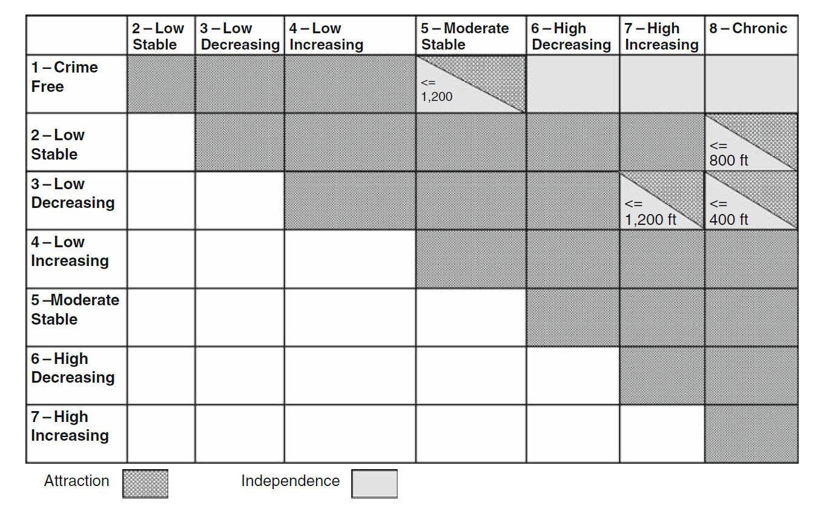
Spatial Attraction, Independence, Repulsion: Bivariate K Statistic
Groff, Elizabeth, David Weisburd and Sue-Ming Yang (2010). Is it Important to Examine Crime
Trends at a Local “Micro” Level? Journal of Quantitative Criminology, 26 (1): 7-32.

Slide 12
“Small Worlds”
There is tremendous heterogeneity in crime patterns at “places.”
  Many hot spots in “good” neighborhoods.
  Many cool spots in “bad” neighborhoods.
Much of the action of crime is lost by studying larger geographic units.

Slide 13
Rethinking the Crime Problem in Cities
Weisburd, David, Shawn Bushway, Cynthia Lum, and Sue-Ming Yang. (2004). Trajectories of Crime at Places: A Longitudinal Study of Street Segments in the City of Seattle. Criminology, 42(2), 283-322.

Slide 14
Crime is Strongly Coupled to Place

Slide 15
Linking Crime and Place
Criminologists did not recognize the importance of “micro” conceptions of place until the 1980s.
  Sherman et al. 1987, 1989: 3 ½ % of addresses, 50% of crime calls.
  Confirmed in a series of studies with different “micro” units of analysis: (e.g see Pierce et al., 1988; Weisburd et al., 1992; Weisburd and Green, 1994; Spellman, 1995)
But is crime tightly coupled to place?
  Do hot spots stay hot, or are there wide fluctuations in the patterns of crime at place across time? (Regression to the mean?)

Slide 16
“Law of Concentration” Over Time
Weisburd, David, Shawn Bushway, Cynthia Lum, and Sue-Ming Yang. (2004). Trajectories of Crime at Places: A Longitudinal Study of Street Segments in the City of Seattle. Criminology, 42(2), 283-322.

Slide 17
Stability of Crime at Place: All Crime
Weisburd, David, Shawn Bushway, Cynthia Lum, and Sue-Ming Yang. (2004). Trajectories of Crime at Places: A Longitudinal Study of Street Segments in the City of Seattle. Criminology, 42(2), 283-322.

Slide 18
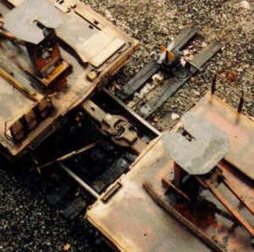
Explaining Crime at Place
The stability of crime trends at places over time suggests a “strong coupling” of crime to place.
  Indicates common underlying causes.
  Study of the correlates of crime at place is only beginning to emerge.

Slide 19
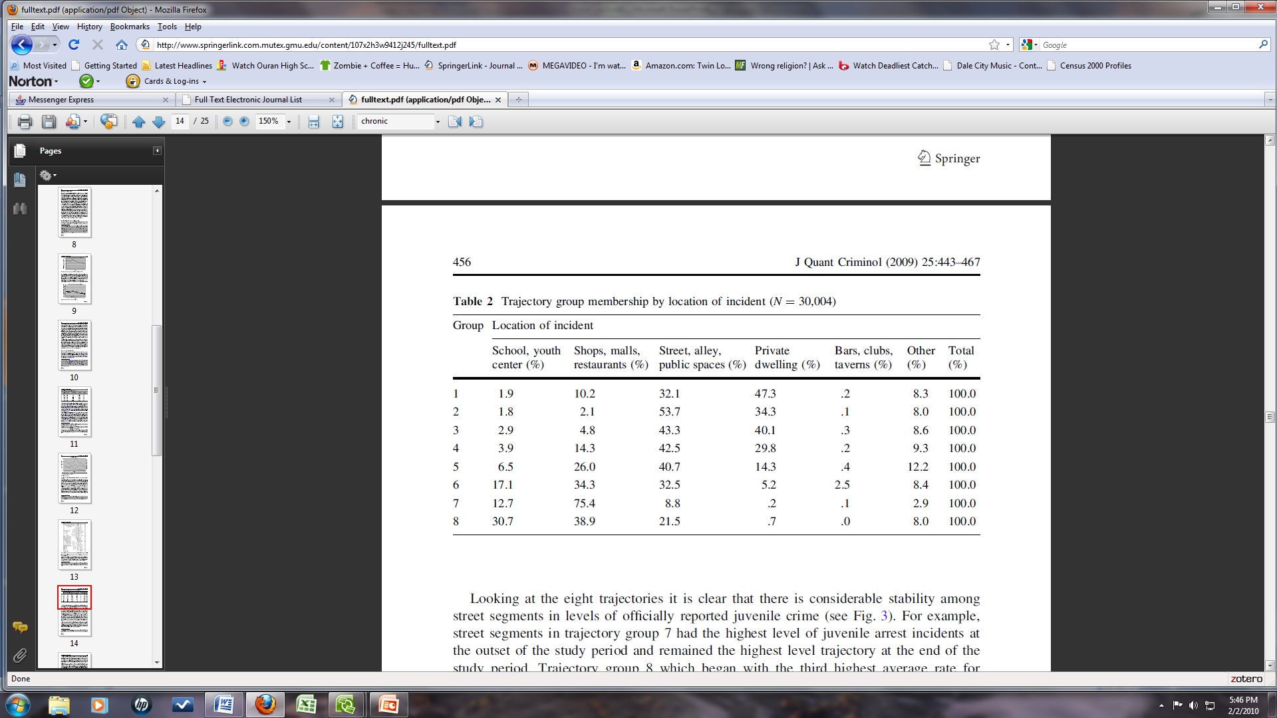
Juvenile Activity Spaces, Unsupervised Socializing, and Juvenile Crime Hot Spots
Weisburd, David, Nancy Morris and Elizabeth Groff. (2009). Hot Spots of Juvenile Crime. Journal of Quantitative Criminology 25:443-467.

Slide 20
Predicting Hot Spots
We have just finished a study that models crime at place across street segments in Seattle (Weisburd, Groff and Yang 2010).
  Models explain almost 70% of variability in crime patterns observed.
    Mean “variance explained” person based studies in Criminology: 32% (Weisburd and Piquero, 2009)
    Statistical support not only for “opportunity” perspectives but also for traditional concerns with social disorganization and crime.

Slide 21
Most Important Predictors of Crime Hot Spots
Variable* |  | Odds Ratio | Standardized Coefficent
Employees |  | 1.075*** | 9.16162
Residents |  | 1.241*** | 5.87801
High Risk Juveniles |  | 2.218*** | 1.67532
Property value |  | 0.704*** | -1.26272
Physical Disorder |  | 25.634*** | 1.23021
Arterial Road |  | 10.870*** | 1.05545
% of Residents Active Voters |  | .041*** | -1.00986
n = 24,023; B = beginning value; C = change variable * p < .05, ** p < .01, *** p < .001 Cox and Snell Pseudo R² = .632; Nagelkerke Pseudo R² = .684 *Other street segment-level variables in the model: Percent of residents on housing assistance, number of truant juveniles, racial heterogeneity, urbanization, mixed land use, street segment length, bus stops, percent vacant land, street lighting, presence of police & fire stations, spatial lag variables, and eight variables related to changes over time.

Slide 22
Crime Prevention at “Micro” Places is a Good Investment
The police can prevent crime!

Slide 23
Isn’t It Obvious?….
“The police do not prevent crime. This is one of the best-kept secrets of modern life. Experts know it, the police know it, but the public does not know it. Yet the police pretend that they are society’s best defense against crime This is a myth.”
—Bayley (1994:3)
“..no evidence exists that augmentation of police forces or equipment, differential patrol strategies, or differential intensities of surveillance have an effect on crime rates.”
—Gottfredson and Hirschi (1990:270)

Slide 24
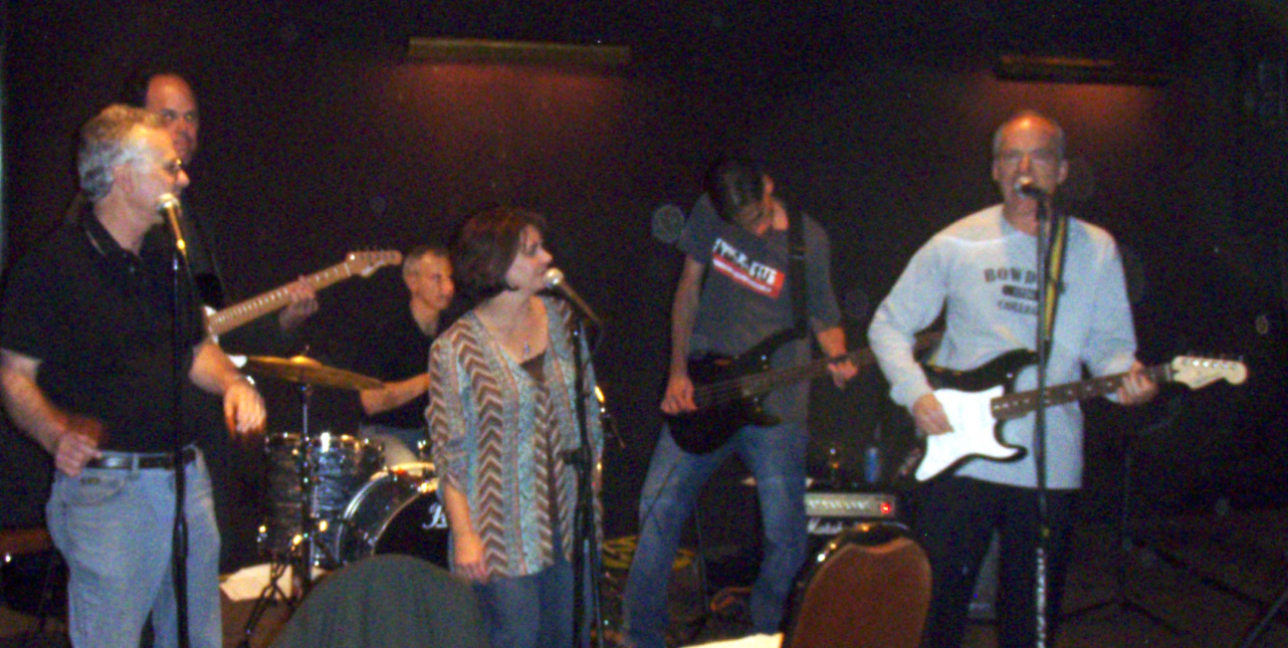
The Minneapolis Hot Spots Experiment (1990)
The first major study to show the potential crime prevention benefits of hot spots policing.
Large experimental field study:
  110 crime hot spots randomly allocated to treatment and control conditions.
  Treatment sites received between 2-3 times the preventive patrol as control sites.
Sherman, Lawrence and David Weisburd. (1995). General Deterrent Effects of Police Patrol in Crime ‘Hot Spots’: A Randomized Study. Justice Quarterly, 12(4), 625-648.

Slide 25
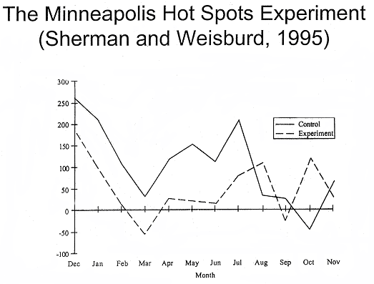
Crime Calls

Slide 26
Strong Evidence Supporting the Hot Spots Policing Approach
The Minneapolis Hot Spots Experiment led to a number of experimental and quasi-experimental studies of hot spots policing.
Braga (2001) identifies nine police “hot spots” studies.
  7/9 studies found crime prevention benefits for the hot spots approach.
  4/5 randomized experiments reviewed found a significant crime prevention benefit at hot spots.

Slide 27
National Research Council Report
“…(S)tudies that focused police resources on crime hot spots provide the strongest collective evidence of police effectiveness that is now available.”
(National Research Council final report on Police Practices and Policies 2004:250)

Slide 28
But Doesn’t Crime Just Move Around the Corner?

Slide 29
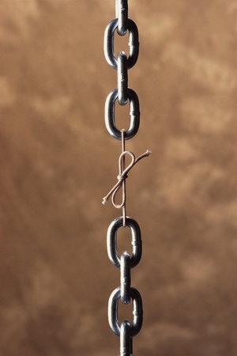
Traditional Assumptions
Crime is “weakly coupled” to place and therefore easily displaced:
  Crime opportunities are numerous
  “Criminal dispositions” not characteristics of places were the driving force of crime (Clarke and Felson 1993:4; Trasler 1993).

Slide 30
“Strong Coupling” and Crime Displacement
Evidence of “strong coupling” of crime and place offers an alternative perspective on the threat of displacement.
  Crime is stable at place because the characteristics of specific places play a key role in the development of crime.
  There is strong resistance to spatial displacement because crime and place are tightly linked.

Slide 31
Jersey City Drug Hot Spots Experiment
The first study of hot spots to systematically examine displacement
56 drug hot spots were randomized to an intervention
  Treatment: problem-oriented policing.
  Control: standard police interventions.
Crime prevention benefits found at the experimental sites.
Weisburd, David and Lorraine Green. (1995). Policing Drug Hot Spots.: The Jersey City Drug Market Analysis Experiment Justice Quarterly, 12(4), 711-735.

Slide 32
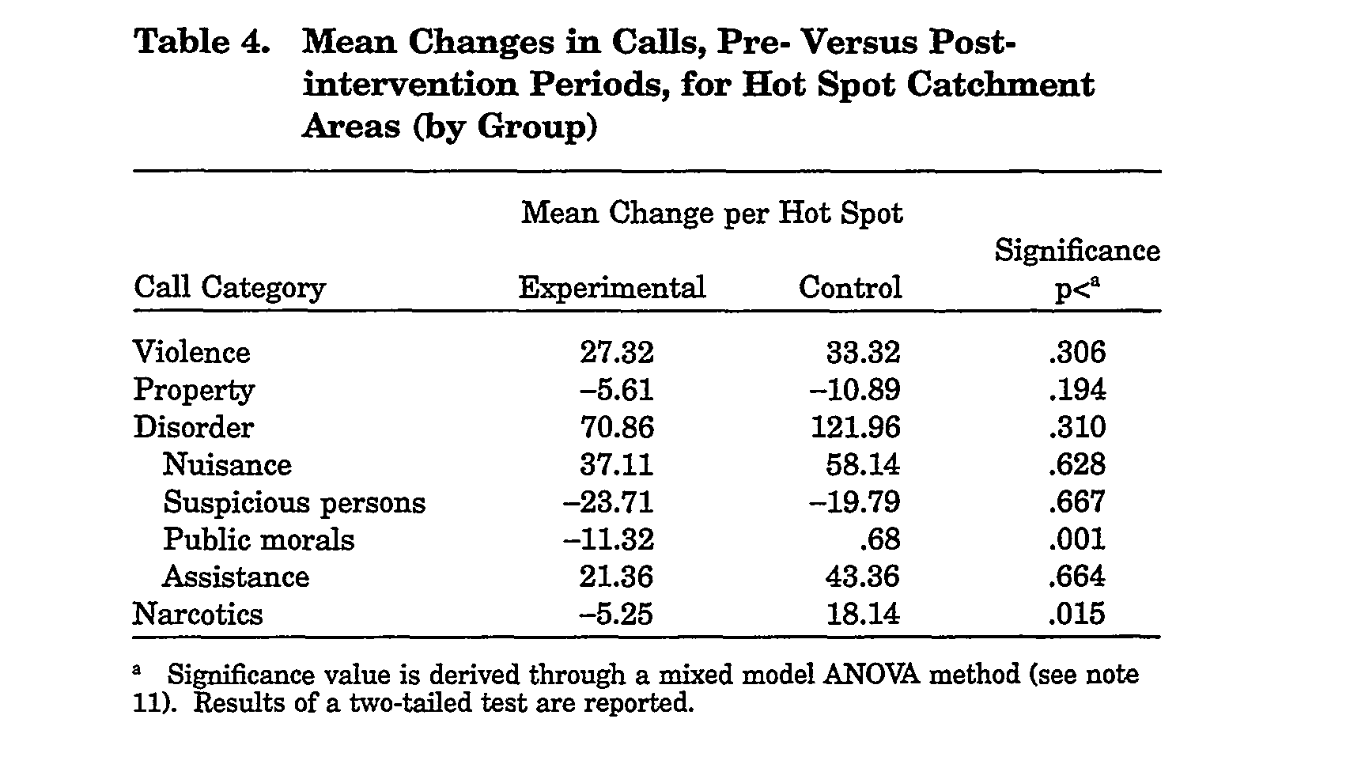
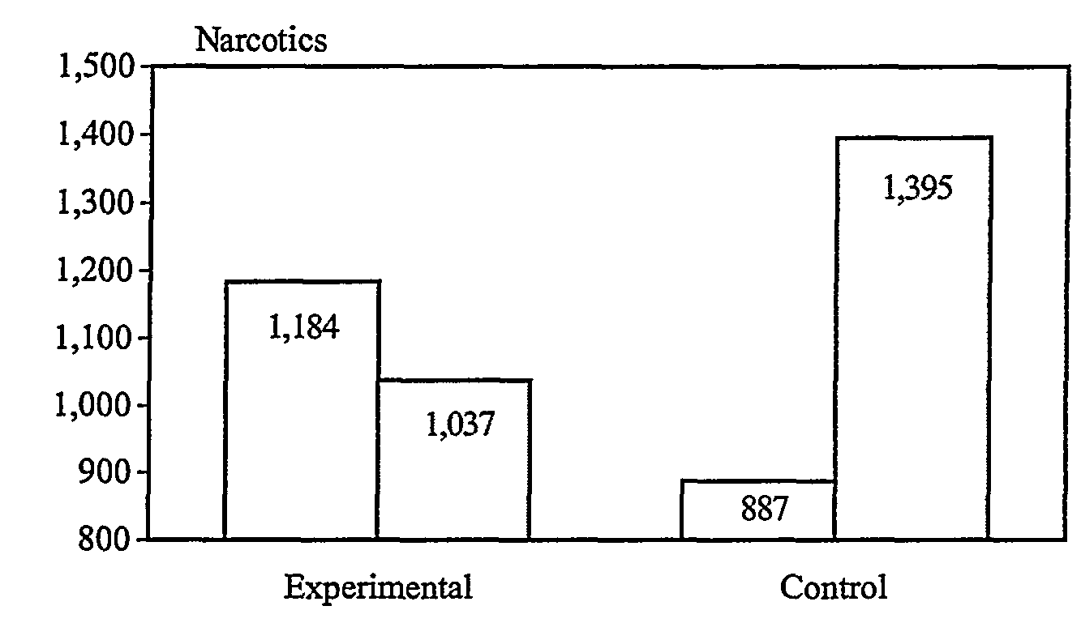
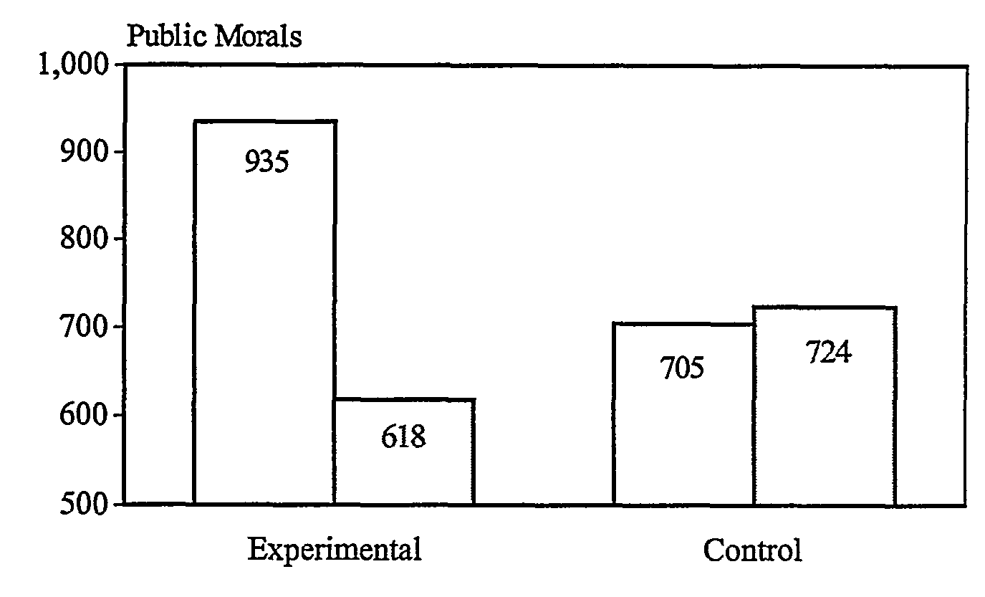
Test of Displacement: Diffusion of Crime Control Benefits

Slide 33
The Evidence and the Problem
Jersey City was followed by other hot spots studies that examined displacement and diffusion of crime control benefits.
  0/5 studies showed immediate spatial displacement.
  4/5 studies showed diffusion of crime control benefits.
Study limitations
  Designed to measure direct crime prevention benefits at hot spots, but were not optimal for examining displacement and diffusion. (“Needle in a Hay Stack,” “Contamination”)
  Lacked qualitative data to get inside the “black box” of “how?” and “why?”

Slide 34
The Police Foundation Displacement and Diffusion Study
Identified optimal sites for displacement and diffusion:
  Excluded sites having very high (“needle in a hay stack”) or low (“diffusion not possible”) levels of crime in surrounding areas.
  Target sites not bounded by physical obstructions (rivers, bridges etc.).
  Predominant criminal activity at site most susceptible to displacement
    Income generating crime (drugs or prostitution)
Two sites received intensive police interventions.
  Systematic social observation of street-level behavior
  Ethnographies and qualitative interviews
Weisburd, David, Laura Wyckoff, Justin Ready, John E. Eck, Joshua C. Hinkle, and Frank Gajewski. (2006)
Does Crime Just Move Around the Corner? A Controlled Study of Spatial Displacement and Diffusion of Crime Control Benefits Criminology 44(3), 549-591.

Slide 35
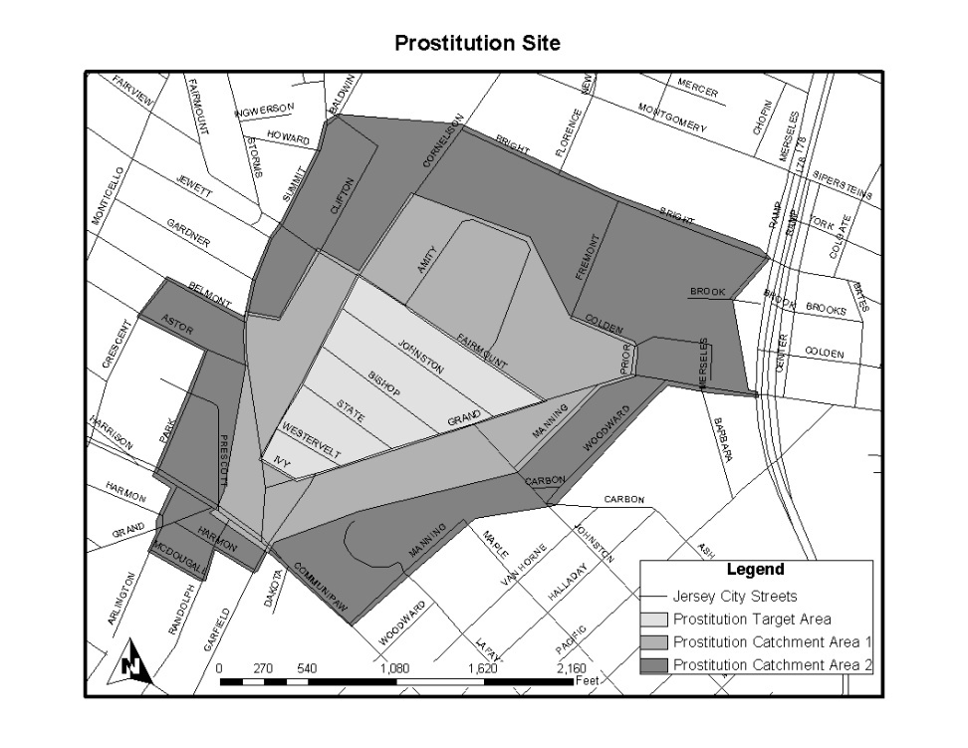
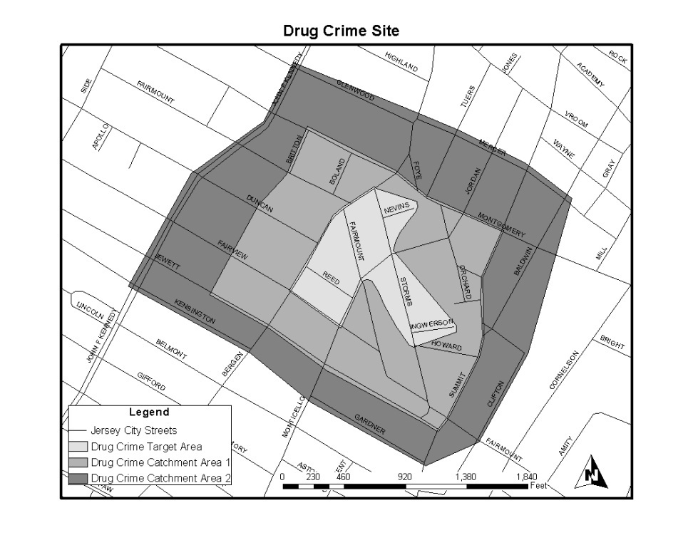
The Sites

Slide 36
Results

Slide 37
Resistance to Spatial Displacement
Criminals are “coupled” to places:
  Criminal activity requires specific types of places:
    “Money won’t be the same”
    “I walked over (to the graveyard cemetery) and I didn’t think I’d make money.”
  Places are “transformed” into crime locations:
    “would have to start from scratch”
    “takes time to build up customers.”
  Territoriality of people in places:
    “(Y)ou really can’t deal in areas you aren’t living in, it ain’t your turf. That’s how people get themselves killed.”

Slide 38
Resistance to Displacement Cont.
People become “attached to places.”
  “It was unfamiliar to me. I didn’t know the guys (clients). On Cornelison you recognize the guys. I know from being out there every day (on Cornelison), the cars, the faces.”
  “Those are not my type of girls.”

Slide 39
Why Diffusion of Crime Control Benefits?
Incapacitation?
  Some offenders were arrested and therefore could not offend in the target or displacement areas.
Deterrence?
  “Bounded Rationality”: Offenders often assumed that the crackdowns were not limited to the target areas but were part of a more general increase in police enforcement. (“Anticipatory Crime Prevention Benefits,” Smith, Clarke and Pease 2002).
Desistence?
  9 of 49 prostitutes interviewed by Brisgone (2004) claimed that they had decided to stop criminal activities altogether.
Empowerment?
  Improvements in the target areas may have led to collective actions in the catchment areas.

Slide 40
Conclusions

Slide 41
The Promise of Place-Based Criminology
The action of crime is at small geographic units like street segments or clusters of street segments.
Crime is strongly coupled to these small geographic units, and we already understand a great deal about “why” crime is concentrated at these places.
Crime prevention at places is a good investment.
    Police can be effective in preventing crime
    Crime does not just move around the corner (“diffusion of crime prevention benefits”)

