Slide 1


“Typhoid Offenders”:
Targeting, Tracking and Testing Criminal Recruiters and Recruits
6th International Conference on Evidence-Based Policing
Ashley Englefield (Cantab.) & Dr Barak Ariel

Slide 2
Targeting Recruiters in Co-Offending Networks

Slide 3
Criminal Recruiters and Recruits
“Both Juveniles and adults may also be vulnerable to the suggestive influence of ‘Typhoid Marys’, or people who accumulate high numbers of co-offenders. These ‘carriers’ are not ringleaders of an ongoing group as much as idea men in a social network, people whose presence in any particular group may tip the balance of action towards committing a violent offense."
Sherman L. (1992). “Attacking crime: police and crime control.” Crime and Justice 15: 159-230

Slide 4
Criminal Recruiters and Recruits
“If we could identify high-rate offenders who recruited a large number of persons into committing delinquent acts or who had a substantial effect on the individual crime rates of a large number of offenders, then these offender recruiters might be targeted for special treatment.”
Reiss, A.J., (1988) “Co-Offending and Criminal Careers’,” Crime and Justice 10: 117-170

Slide 5
Evidence on Recruiters
Elaborate body of evidence on co-offenders and criminal networks
  McGloin & Piquero (2010); Carrington (2009 ); Xu & Chen (2005); Bruinsma & Bernasco (2004); Sparrow (1991); Reiss (1988)
Growing yet limited research on Recruiters/ Influential Nods/ Centrality
  Sarnecki (1990)
  Reiss and Farrington (1991)
  Warr (1996)
  Farrington and van Mastrigt (2011)
  Tayebi et al (2011)
  McGloin and Nguyen (2012)

Slide 6
Definition of Recruiters
  “Responsible for introducing individuals into a pattern of repeated criminal behavior” (Reiss & Farrington 1991)
  “Instigation of co-offending” (McGloin & Nguyen 2012)
  Operationally defined as (Farrington and Mastrigt 2011):
      “prolific offenders”, having 10+ offenses in 36 months;
      At least 5 co-offenders
      at least 51% of co-offenders younger than themselves

Slide 7
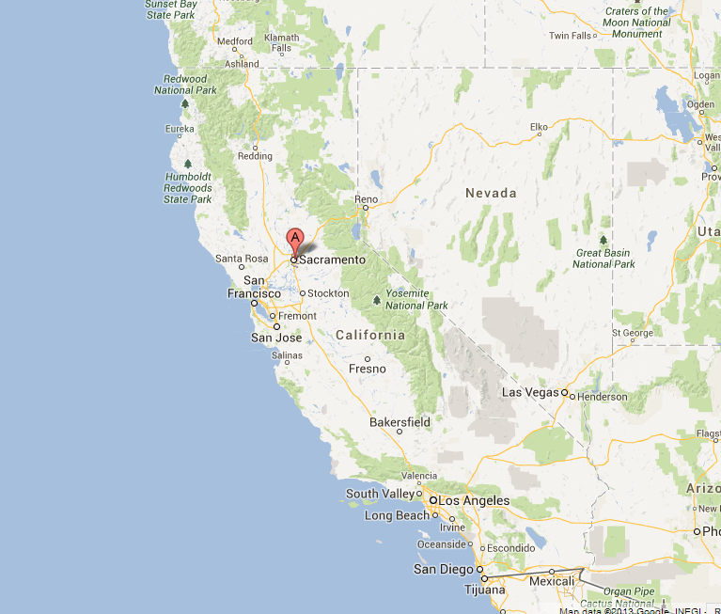
Recruiters and Recruits in Sacramento

Slide 8
Sacramento Police Department Data
2004 - 2012
80,245 persons arrested
  53,268 persons arrested only once (66%)
  112,963 instances of solo arrest (88%)
128,629 cases where an arrest was made
251,285 distinct charges

Slide 9
Co-Offending Rates
CRIME CLASS | TOTAL CRIME % | % WITHIN CRIME CATEGORY
SCHOOL OFFENSE | 0.39% | 28.03%
ROBBERY | 2.56% | 24.53%
HOMICIDE | 0.30% | 21.50%
BURGLARY | 5.78% | 20.24%
MUNICIPAL CODE | 1.76% | 15.84%
PROPERTY CRIME | 3.86% | 14.72%
ARSON | 0.20% | 14.51%
ALCOHOL | 1.08% | 13.23%
PUBLIC ORDER | 4.93% | 12.41%
GRAND MEAN | ---------- | 11.89%

Slide 10
Searching for Recruiters & Recruits in SPD
Recruiter → 3+ arrests
→ 3+ co-offenders
Recruit → first-time offender
→ younger than the recruiter

Slide 11
Recruiters / Recruits Found
1,092 Typhoid Recruiters (1.36%)
4,157 Typhoid Recruits (5.18%)
(Offender Population = 80,245)

Slide 12
Recruiters (N= 1,092)
 | AVERAGES
Arrests | 6.37
Solo Arrests | 2.39
Total Co-Offenders* | 5.44
Younger Co-Offenders | 4.01
First Time Co-Offenders | 2.11
Average Age Difference | 4.04
Average Age of Co-Offender at Arrest | 24.55
*All co-offenders including recruits

Slide 13
Percent of Cases with a Recruiter (Within Crime Categories)

Slide 14
Recruiters’ Involvement in Crime
(Charges)

Slide 15
Recruiters’ Involvement in Crime
(arrests)
CLASS | % of Recruiters | % of all Offenders
NARCOTICS | 74.73% | 31.23%
PROBATION/PAROLE | 58.79% | 17.59%
ASSAULT | 37.55% | 27.36%
LARCENY | 37.27% | 21.95%
BURGLARY | 35.99% | 9.13%
JUDICIAL | 35.81% | 12.07%
WEAPONS | 31.41% | 9.01%
PROPERTY CRIME | 30.31% | 6.36%
PUBLIC ORDER | 27.11% | 7.09%
ROBBERY | 26.92% | 4.75%

Slide 16
Recruits (N=4,157)

Slide 17
Recruits’ Involvement in Crime
(arrests)
CLASS | % of Recruits | % of all Offenders
NARCOTICS | 57.54% | 31.23%
PROBATION/PAROLE | 35.60% | 17.59%
ASSAULT | 28.41% | 27.36%
LARCENY | 28.36% | 21.95%
BURGLARY | 26.68% | 9.13%
JUDICIAL | 24.15% | 12.07%
PROPERTY CRIME | 20.28% | 6.36%
WEAPONS | 19.58% | 9.01%
ROBBERY | 19.51% | 4.75%
PUBLIC ORDER | 19.29% | 7.09%

Slide 18
Tracking influential Nodes in Co-Offending Networks

Slide 19
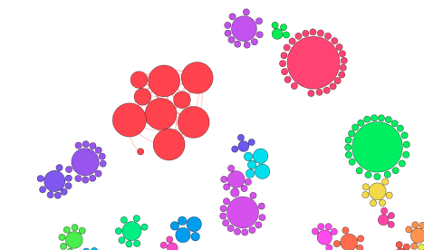
Network Analysis
(“small world” topology; Watts & Strogatz 1998)
Recruiters and Co-Offenders
Node size represents total degrees (connections)
Colour represents modularity (groupings)

Slide 20
Network Analysis
Auto Theft 9.36%
Typhoid Recruiters - 27
Typhoid Recruits - 146

Slide 21
Network Analysis
Burglary 21.68%
Typhoid Recruiters - 482
Typhoid Recruits - 2003

Slide 22
Network Analysis
Robbery 26.32%
Typhoid Recruiters - 377
Typhoid Recruits - 1599

Slide 23
Network Analysis
Narcotics 32.38%
Typhoid Recruiters - 1040
Typhoid Recruits - 3848

Slide 24
Network Analysis
Overall - 40.27%
Typhoid Recruiters - 1092
Typhoid Recruits - 4157

Slide 26
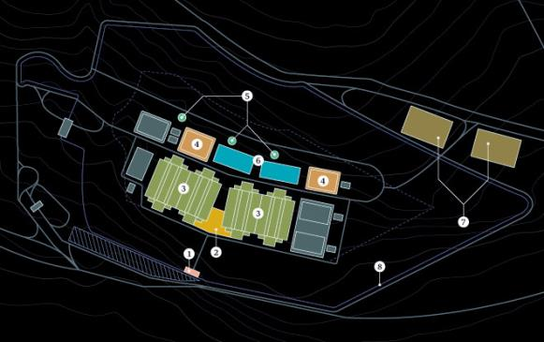
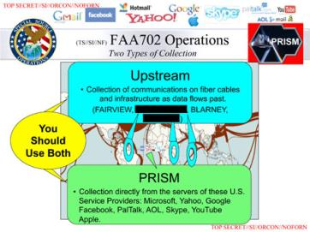
NSA – ‘PRISM’

Slide 27

Testing Focused and Vicarious Deterrence:
Targeting Recruiters and its Effect on Recruits – A Randomized Controlled Trial

Slide 28
Can We Effect Recruits by Targeting Their Recruiters?
  Two Hypotheses:
    Focused Deterrence: Increased police control over Recruiters will reduce reoffending of these Recruiters, compared to Recruiters who are not subject to similar control measures
    Vicarious Deterrence: Increased police control over Recruiters will reduce reoffending of those that are recruited by these Recruiters, compared to “control recruits”

Slide 29
Intervention
      Monthly “Knock and Talk” face-to-face encounter by uniformed officers
      takes place anywhere, including but not limited to Recruiter’s home of residence, vehicle, or place of employment
Recruiter is formally advised (script) that he or she is subject of increased police scrutiny
“PJ contact card” is given to recruiter with a list of resources available for the recruiter to assist with drug rehabilitation, jobs, counselling, etc.

Slide 30
Random Allocation
Random Allocation within 6 Districts in Sacramento, of 421 eligible recruiters
  206 Prolific Offenders – Treatment Group
    (Associated with 991 Recruits)
  215 Prolific Offenders – Control Group
    (Associated with 1,014 Recruits)
baseline comparability in terms of arrests, recruit count, age of co-offender and total n co-offender - none of the t-tests were statistically significant at p < .1

Slide 31
(very) Preliminary Results – Arrests
D = -0.9 {CI = (-1.7)-(-0.1)}

Slide 32
(very) Preliminary Results – Charges
D = -0.6 {CI = (-0.9)-(-0.3)}
D = -0.2 {CI = (-0.5)-(0.2)}

Slide 33
“Typhoid Offenders”:
Targeting, Tracking and Testing Criminal Recruiters and Recruits
6th International Conference on Evidence-Based Policing
Ashley Englefield (Cantab.) & Dr Barak Ariel

