Slide 1


‘Adapting the Blues’
Sir Denis O’Connor CBE QPM
Her Majesty’s Chief Inspector of Constabulary
4th July 2011
4th International Evidence Based Policing Conference

Slide 2
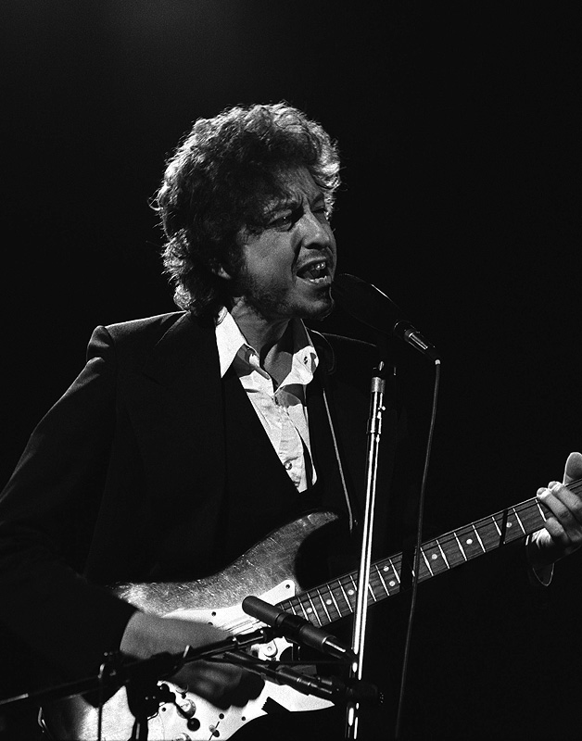
Tangled up in blue
What lies beneath….
“Her folks they said our lives together
Sure was gonna be rough…
Lord knows I’ve paid some dues getting through
Tangled up in blue.”
Bob Dylan

Slide 3
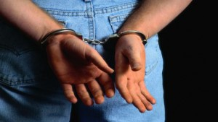

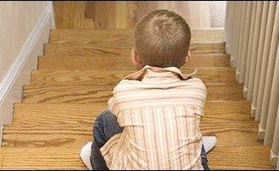
Policing is intrinsically adaptive
A simple shop-lifting call …
…could turn out to be
a child protection case

Slide 4

Adaptation … lessons from nature

Slide 5
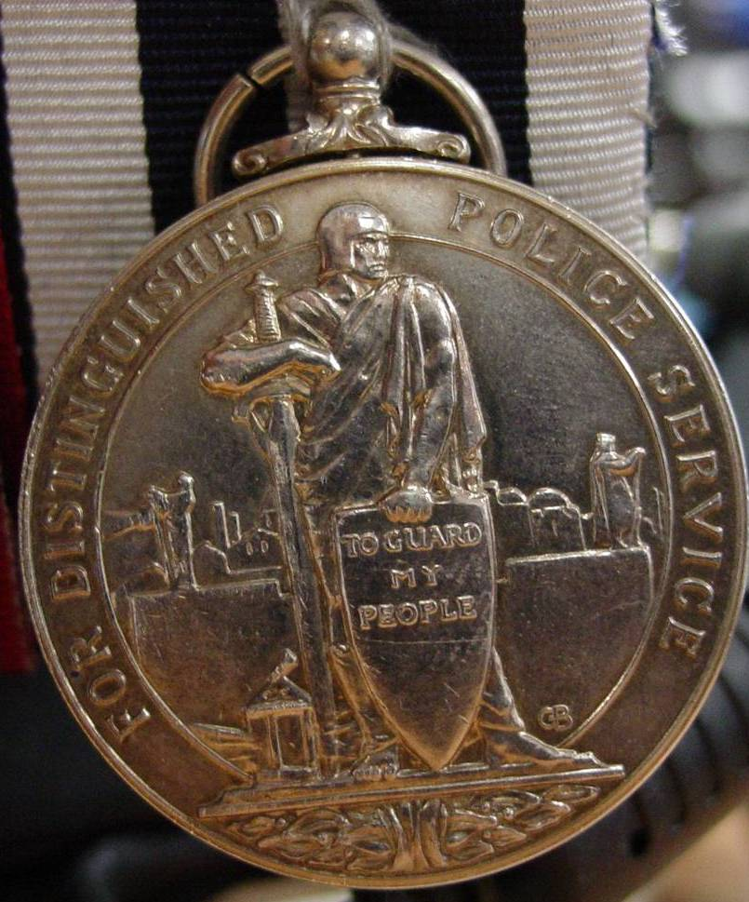
Our Noble Mission

Slide 6
What lies beneath….
“The wicked flee when
no man pursueth…”
Proverbs 28:1

Slide 7
Some questions for you….
What lies beneath….
Please tick one or more of the following:
Is your research geared to:
Generational austerity?
Garnering the political will to make the necessary hard choices?
Being able to inform the ‘better for less’ requirement of police leadership?

Slide 8
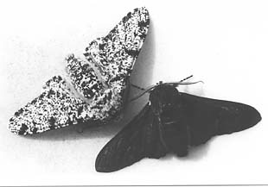
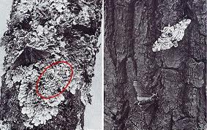
The case of the peppered moth
What lies beneath….
“The significance of an adaptation can only be understood in relation
to the total biology
of the species” J. S. Huxley

Slide 9
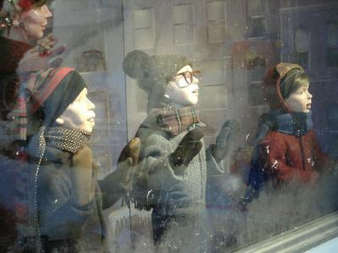
‘Outside in’…
What lies beneath….

Slide 10
US / England & Wales Crime trends 1981 – 2011
What lies beneath….

Slide 11
The “Reassurance Gap”
Since 1997 crime spending has increased and overall crime has been reduced by 32% yet confidence in the government to stop crime is low.
When Mori asked respondents, only 20% were willing to accept crime overall is actually declining
Source: IPSOS MORI - ‘Closing the Gaps: Crime and Public Perceptions’.

Slide 12
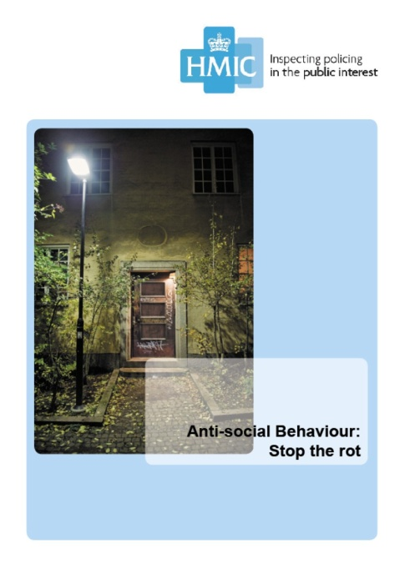
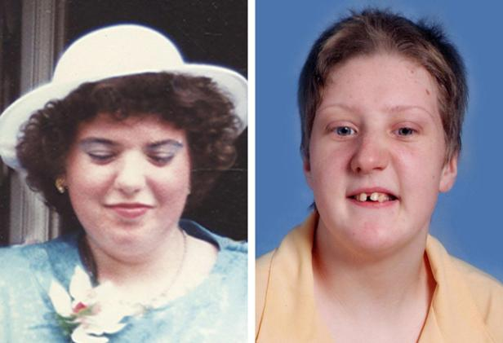
ASB has not gone away
What lies beneath….

Slide 13
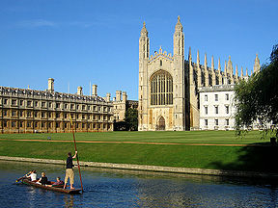

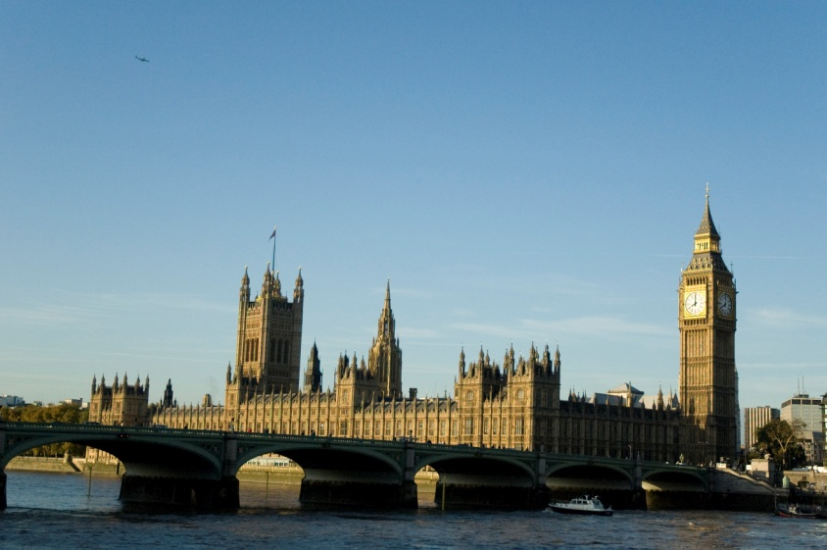
The real story of adaptation
What lies beneath….
The big changes depended on:
Explanation (research)
Operationalising (police leadership)
Promotion (politicians)

Slide 14
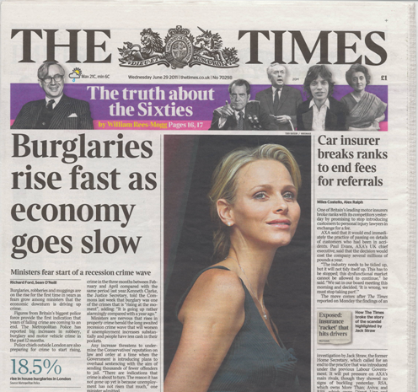
Crime can go up as well as down
BCS reductions flattening
Forces already declaring crime rises
1995 – 2010 BCS and recorded crime

Slide 15
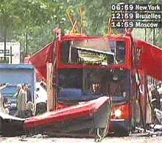
The changing police / security paradigm
“Once in a while a door opens, and lets the future in”
Graham Greene
Notes:
No explanation required!

Slide 16
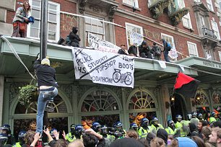
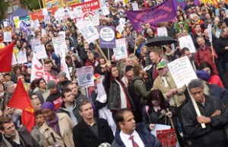
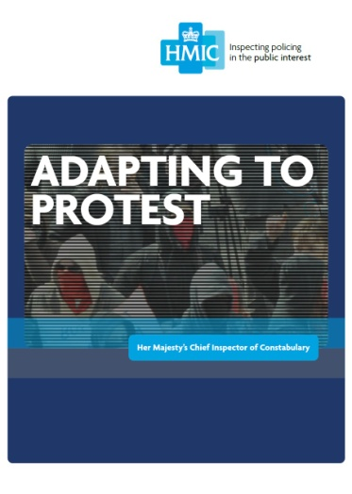
Adapting to Protest
Peaceful protest
or
criminal activity
or
BOTH?

Slide 17
Austerity bites
What lies beneath….
5 - 10% ….
10 - 20% ….
20% +….

Slide 18
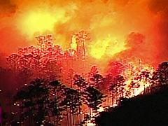
Disruption and change
What lies beneath….
Florida brush fire

Slide 19



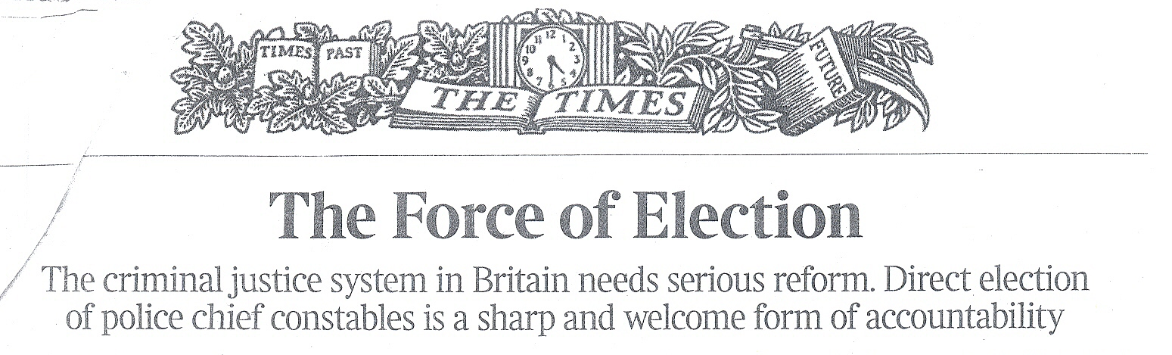

Leadership in a Policing revolution
Simultaneous policing revolution in
Accountability
Funding
National Institutions

Slide 20
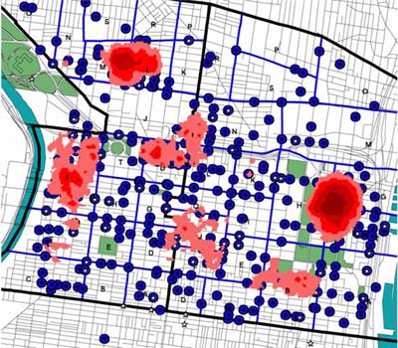
City Hot Spots
Courtesy of Lawrence W. Sherman

Slide 21
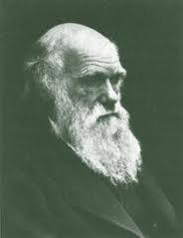
What lies beneath….
“…believing as I do that man in the distant future will be
a far more perfect creature than he now is.”
Charles Darwin

Slide 22
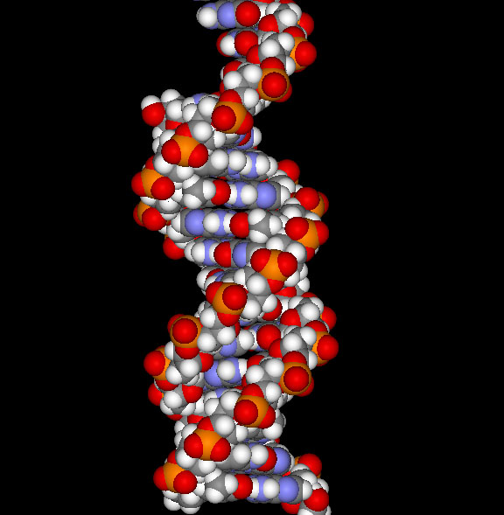
DNA

Slide 23
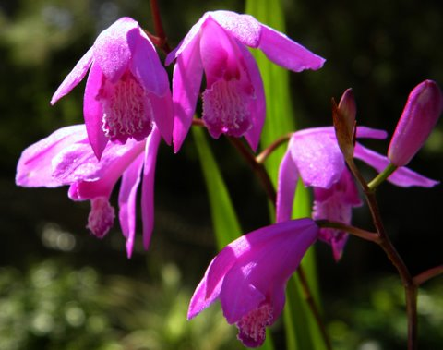
A hardy hybrid
What lies beneath….
Striata Hybrids Bletilla

Slide 24
What lies beneath….
“The wicked flee when
no man pursueth;
but the righteous are
as bold as a lion”
Proverbs 28:1

Slide 25
Any Questions?
Sir Denis O’Connor CBE QPM
Her Majesty’s Chief Inspector of Constabulary
4th July 2011
4th International Evidence Based Policing Conference

