Slide 1
How should ministers and parliament be educated on evidence?
David Howarth
Clare College

Slide 2
Decision vs Presentation
Classical model
  We decide what to do, then we decide how to present it in the best light
New model
  We decide what we want to say, then we decide what we have to do to stand our ‘story’ up
“Strategic communication is now the whole of politics”

Slide 3
Ex ante vs Ex post explanation
Ex ante:
  Specify goals in advance
  Clear priority of goals
  Clear tests of success/ failure
Ex post
  Cluster of conflicting goals
  Choose goals ex post on basis of :
    Which ones can’t be falsified
    Which ones turned out well

Slide 4
Whitehall vs Westminster
Whitehall model
  Decide, announce, defend
    Consult only on modalities
    Obscure costs of alternatives
Westminster model
  Debate, wait, attack
    Difficult to propose alternatives
    Scrutiny after the fact, not before
    “Duty to oppose”

Slide 5
Fast vs Slow
Slow policymaking route
  Green papers, select committee reports
  Many opportunities for input, evidence
  But beware of the shelf
Fast policymaking route
  Crises, report stages of bills, statements
  No time for new evidence/ thought
  Has to be in place already

Slide 6
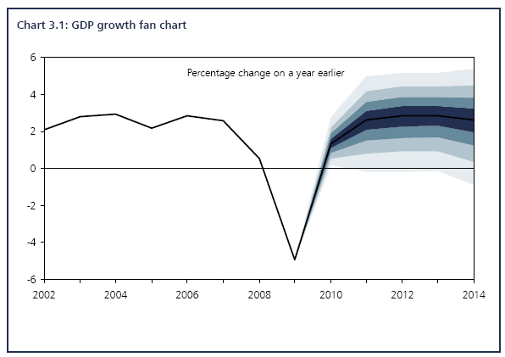
Uncertainty vs Certainty
Fan diagrams – Office of Budget Responsibility

Slide 7
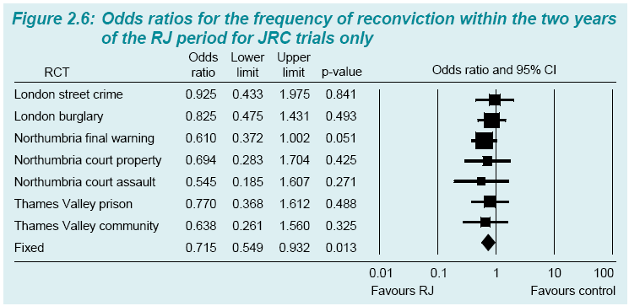
Uncertainty vs Certainty
Forest plots – Shapland Report

Slide 8
Uncertainty vs Certainty
Publication of uncertainty unwelcome in classical model, esp. in Whitehall
  Relevant to decision, but complicates ‘defend’ phase
  Tell us the risks, but we will deal with them in our way
Uncertainty even less welcome in new model
  ‘Stories’ have no room for uncertainty/ risk
  Risks must either be exaggerated or ignored

Slide 9
Example: Penal Policy
Evidence (as known to MoJ):
  Short prison sentences very ineffective and v expensive
  Drug treatment (property) and alcohol treatment (violence) reasonably effective
  D/A treatment more effective outside prison
  Prison less ineffective if housing/employment/ education/ relationships
  Restorative justice effective and cheap

Slide 10
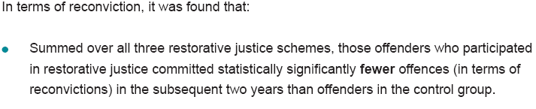
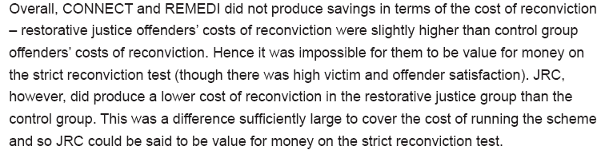
Conclusive?

Slide 11
Penal Policy 1995-2010
Big build up of evidence over time
  Parliamentary slow model (select committees etc)
But no overt change in policy after ‘prison works’
Why?

Slide 12
Penal Policy 1995-2010
New model process impervious to evidence
  What do we want to say?
    “Tough on crime” (=prison)
  What do we do?
    Signal more prison and longer sentences
  Leads to crisis, but what is new model response?
  Must stand up story, therefore build new prisons

Slide 13
Penal Policy 1995-2010
Ex post evaluation style
  Cloud of conflicting goals/ future stories
  “Punishment” in lead because no evidence needed (Editor of Daily Mail as survey with N=1?)
  BCS crime rate also used, because happened to be convenient and available (but nb international comparisons ignored)

Slide 14
Penal Policy 2010
Fiscal Crisis
Ultra-fast process
  No time for new evidence or analysis
  Go with what we have:
    Prison doesn’t work – cancel building programme
    Cheaper alternatives that do work instead
    Don’t know which works best, so market process
Better policy but problems:
  What are ex ante goals?
  Evidence-compatible rather than evidence-based

Slide 15
Conclusion
Understanding policy process includes understanding politics
Politics can change
Keep feeding in evidence even when it is not welcome, because a time might come when it is welcome

