Slide 1









The Cambridge Randomizer
Sycamore Tree Programme Evaluation

Slide 2
The Problem:
In carefully designed experiments, random assignment (RA) procedures can be quite expensive, time-consuming and difficult to manage
RA is usually carried out by the research team, not the treatment-provider, in order to increase the likelihood that the integrity of the research will not be challenged.
Can treatment providers conduct the RA themselves, without jeopardizing the integrity of the RCT?

Slide 3
The Cambridge Randomizer
A low-cost, secure and user-friendly online portal for RA
Treatment-providers can now conduct the RA themselves :
  Secure log-in (meets data protection demands)
  Assess eligibility of cases to participate in the RCT
  provide instantaneous baseline information for each case
Immediate random llocation into treatment and control groups.
The Randomizer automatically sends an electronic report to the research team with each case that goes through the pipeline → Researchers maintain control over the scientific process
Both quantitative and qualitative data can be accommodated.

Slide 4
“Random Assignment Without Tears”

Slide 5
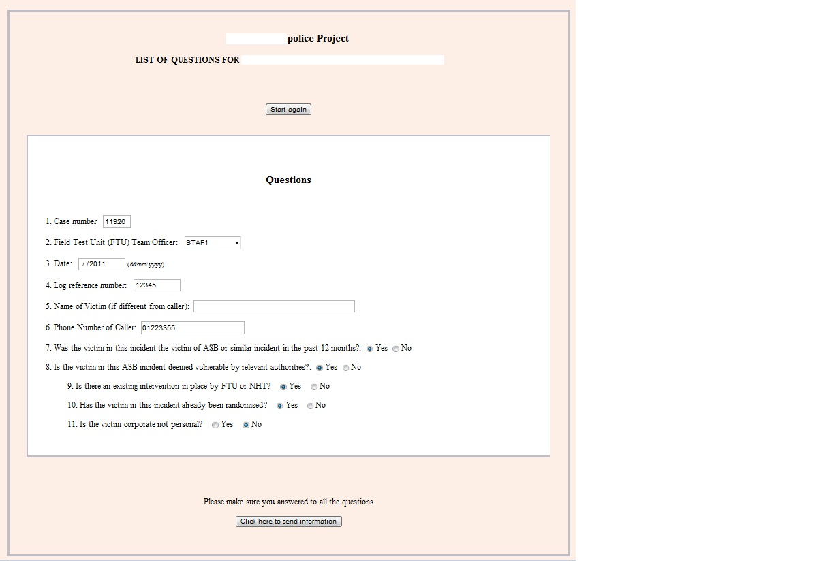

Slide 6
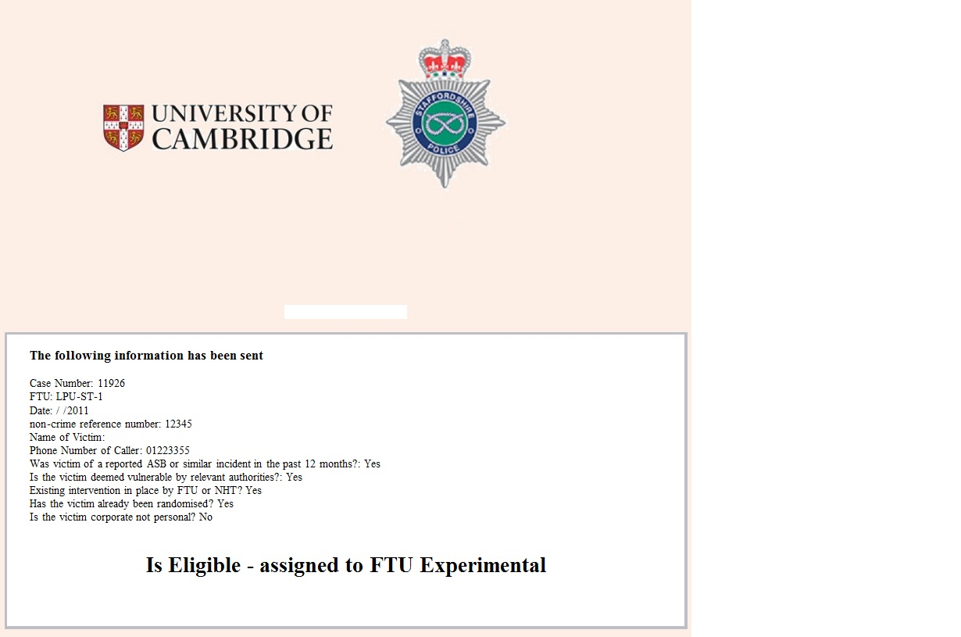

Slide 7
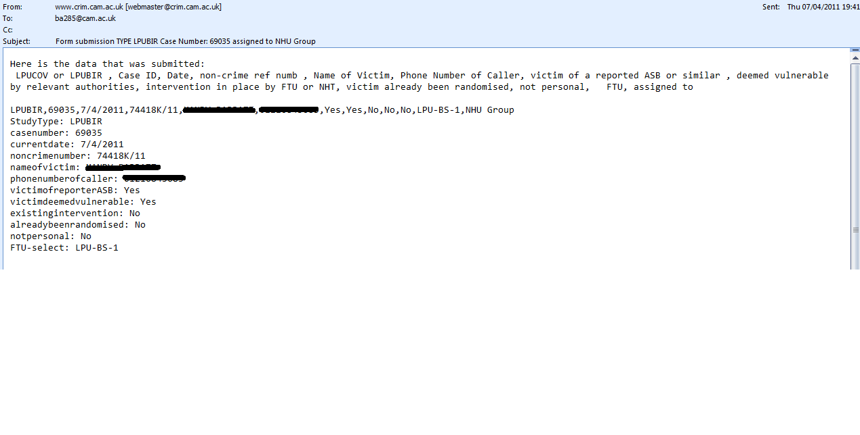

Slide 8
Ariel, Barak, Lawrence Sherman and Jordi Vila (forthcoming?). “Random Assignment without Tears: How to Stop Worrying and Love the Cambridge Randomizer.” Journal of Experimental Criminology
ba285@cam.ac.uk
Sycamore Tree Programme Evaluation

