Slide 1
INSTITUTIONALIZING EVIDENCE INTO PRACTICE The Matrix Demonstration Project Cynthia Lum Center for Evidence-Based Crime Policy
GEORGE MASON UNIVERSITY

Slide 2
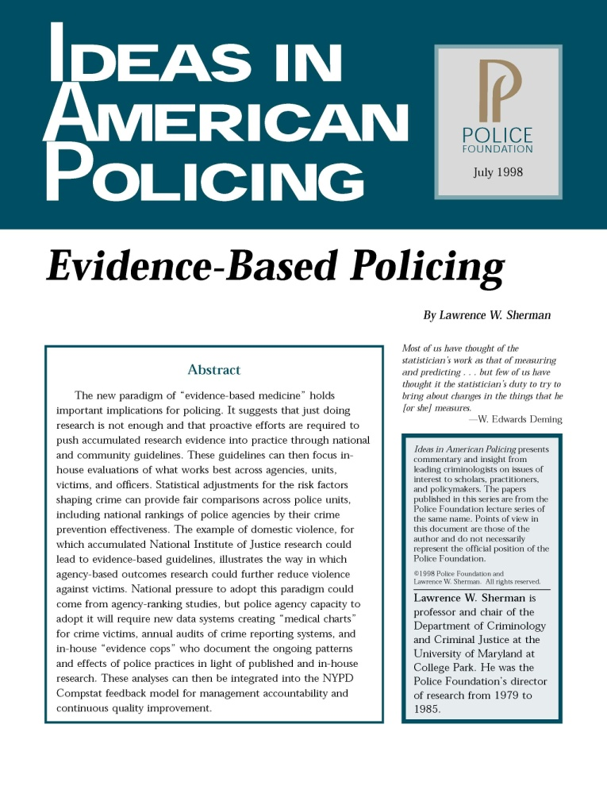
Evidence-Based Policing
Policies and practices that are supported by rigorous evidence
Decision making incorporates scientific processes

Slide 3
Evidence-Based Policing
Evidence-based policing occurs when research findings and scientific processes are used in police practice.
(1) Is this occurring?
(2) If not, how do we accomplish this?

Slide 4
Is Evidence-Based Policing Occurring?
(How can we detect evidence-based policing?)

Slide 5
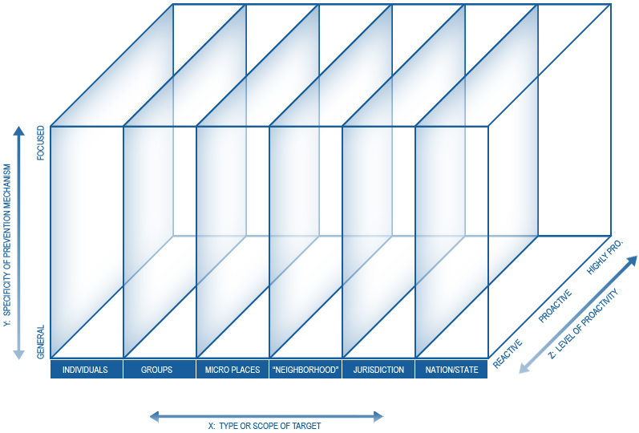
N=103 (Dec 2010)
Significant Backfire Non-Significant Finding Mixed Results Significant /Effective

Slide 6
What would an evidence-based police agency ‘look like’?
79% of successful interventions studied occur at “micro-places” or “neighborhoods”.
64% of successful interventions are “focused”, or tailored strategies.
80% of successful interventions are either “proactive” or “highly proactive”.
53% of interventions that show “no effect” or a “backfire effect” focus on targeting individual(s).

Slide 7
Are police today “evidence-based”? YES
Rhetoric and diffusion of innovation (conferences, leaders).
Ad hoc use of effective interventions and specialized units.
Ad hoc serious evaluations in police agencies.
Required by government solicitations.*
Increased importance of crime analysis and researchers.
Notes:
BJA Solicitation Wording:
Or “Priority consideration will be given to those applicants that choose to replicate strategies that are proactive, focused rather than general, and have produced statistically significant findings of effectiveness. Resources to identify evidence-based law enforcement strategies include George Mason University’s Evidence-Based Policing Matrix.

Slide 8
Are police today “evidence-based”? NO
Reactive, random beat patrol continues to dominate.
Investigations: reactive, individual, case-by-case.
Continued isolation from other agencies.
Problem-solving/analytic process not regulated.
Lack of professional development in this area.
Some disdain/isolation of researchers and analysts.

Slide 9
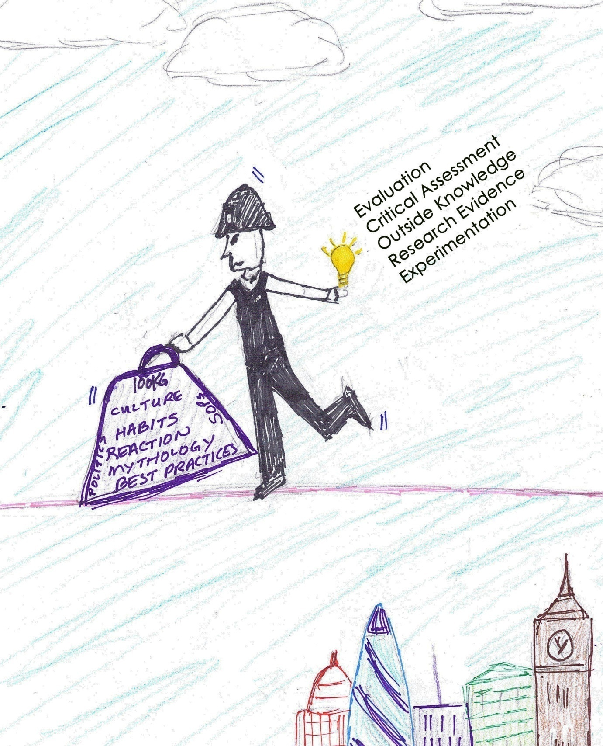

Slide 10
Closing the gap of evidence-based policing
The Science
Evaluations
Infrastructure Needed
Translation tools
E-B funding
The Practice
Tactics
Systematic Reviews
Methods development
IT systems
Agency cultural ∆
Deployment strategies
Implemented policies
Technical assistance
Early innovators
Academic cultural ∆

Slide 11
The Matrix Demonstration Project
Institutionalizing research into daily practices

Slide 12


Slide 13
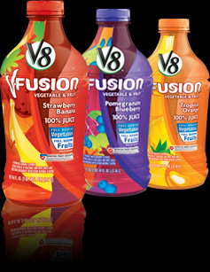

Slide 14
Five areas for institutionalizing evidence
Deployment: Tactics and strategies
Accountability systems: promotions and assessment
Management and leadership: Compstat, etc.
Professional development: academy, field training, in-service
Planning: Crime analysis and statistics

Slide 15

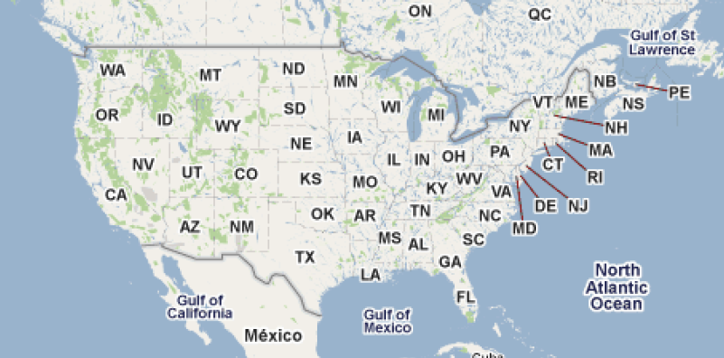
Alexandria Police Department
The field training checklist “switch-a-roo”

Slide 16

Redlands Police Department
Different jokes for different folks

Slide 17

Richmond Police Department
Management meetings as learning environments

Slide 18
Using The Matrix as a Translation Tool
Hot Lists
Education and COP
LPR, hot spots, education
Significant Backfire Non-Significant Finding Mixed Results Significant /Effective

Slide 19
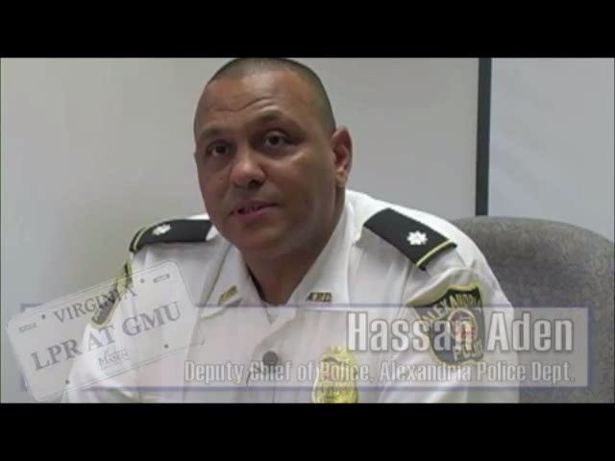
Richmond Police Department
Management meetings as learning environments

Slide 20

Minneapolis Police Department
Call codes and developing good habits

Slide 21
The Bottom Line
Evidence-based policing is about USE of science in practice.
Need translation tools and vehicles to make reform happen within everyday police practices.
Need to develop and test these vehicles, in addition to testing actual interventions.

Slide 22

The Matrix Demonstration Project www.policingmatrix.org Cynthia Lum Christopher Koper Cody Telep Center for Evidence-Based Crime Policy George Mason University

