Slide 1



The Birmingham and Peterborough PCSO Hot Spots Experiments Operation Savvy + Operation Style
6th International Conference on Evidence-Based Policing
Dr Barak Ariel
Neil Wain (PhD Cand.)
Cristobal Weinborn (PhD Cand.)
Sgt. Wendy Goodhill
Insp. Rob Hill
Prof Lawrence Sherman

Slide 2
Background
"Law of concentrations of crime at place”
(Weisburd, Telep, Braga & Groff 2010:167; Sherman et al 1989)
General deterrence (prevention) and rational choice theories
- (Sherman and Weisburd, 1995)
20 of 25 tests of hot spots policing interventions worldwide reported noteworthy crime and disorder reductions
(Braga, Papachristos & Hureau 2012)
The benefits of increased officer time spent in the hot spot plateau around 15 minutes
(Koper, 1995; Telep , Mitchell & Weisburd, 2012)

Slide 3
Unanswered Questions in Place-Based Police Initiatives

Slide 4
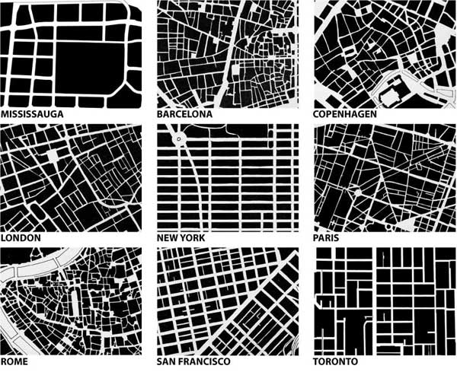
Does hotspots policing work in non-grid layouts?

Slide 5

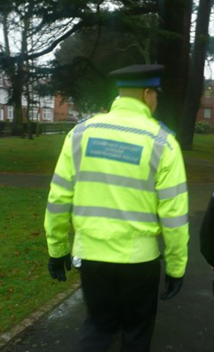

Other types of capable guardians?

Slide 6
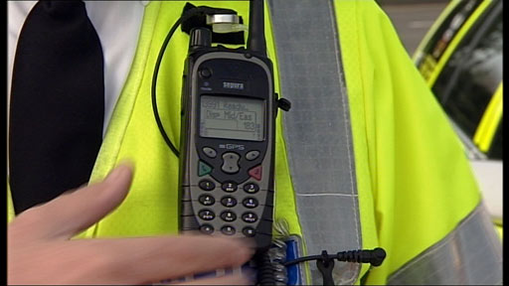
Dosage and Tracking – in both Experimental and Control Conditions
Time spent in hotspots:
Total time of all officers
Officers involved in the experiment
What is the optimal number of visits per shift?
“business as usual” tracking of patrol
In untreated areas – is it really business
as usual?

Slide 7
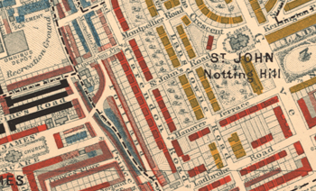
Effect Conditional on history of hotspot
“Super stubborn hotspots” are immune to 15-minute, 3 visits per shift patrols in LU, but what about above ground?
(Ariel and Sherman, forthcoming)
Test the effect of intervention as a function of the socio-demographic and criminogenic attributes of the hotspot, over a 10-year period
(Weinborn and Ariel, forthcoming)
Measure non-crime outcomes
(Weinborn and Ariel, forthcoming)
(Weisburd, Ariel and Ilan, forthcoming)

Slide 8
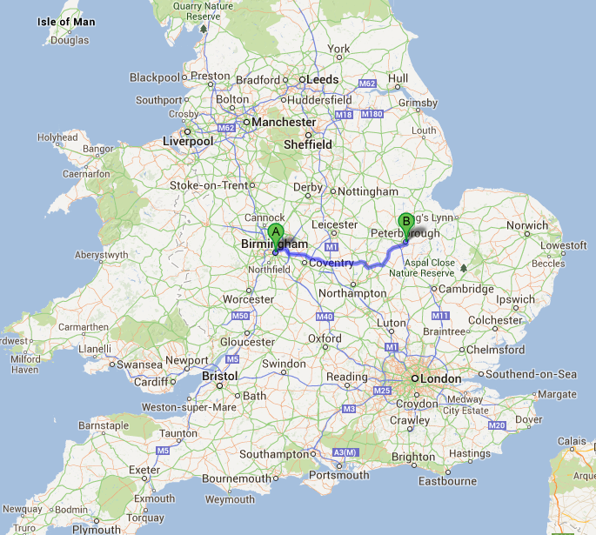
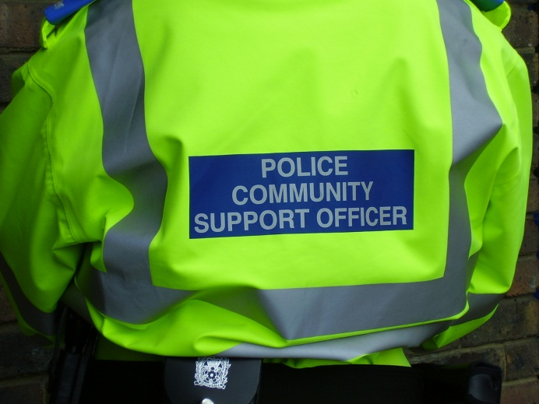
The Birmingham and Peterborough PCSO Hot Spots Experiments
Operations Savvy + Style

Slide 9
Context
4th and 5th Evidence-Based Policing Conferences
Austerity crisis/opportunity
Future of foot patrol / PCSOs
Does hotspot policing work in the UK?

Slide 10
Overall Research Design
Multisite randomised controlled trial
Random assignment of all hotspots within 3 blocks of ‘heat’
Intervention delivered by PCSOs only
3 X 15-minute patrols, Wed-Sat, 3-10PM, in treatment hotspots
“business as usual” in control hotspots
GPS locators on all front-line officers (radios)

Slide 11
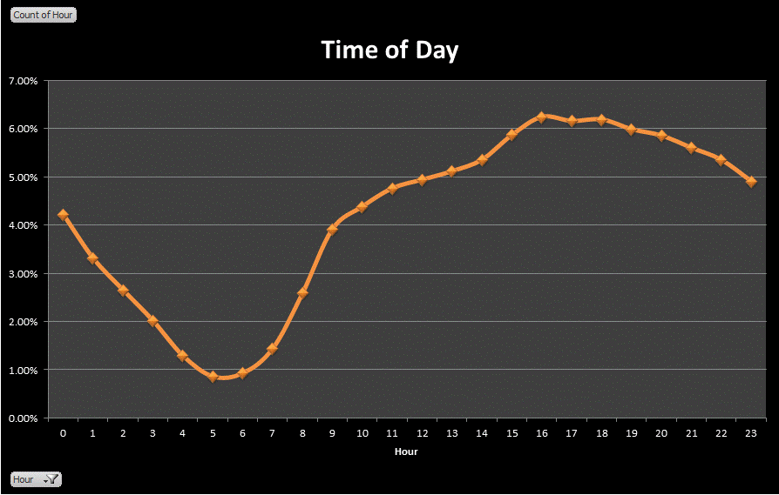
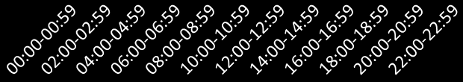
Baseline Analyses - Temporal
Peterborough (48-month data) Hourly Distribution of Crime (n= 127,299)

Slide 12
Incident Type

Slide 13
Crime Hotspots

Slide 14

Operation Savvy

Slide 15
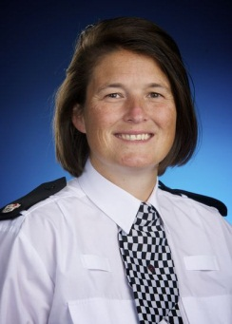
Unique Features
Superintendent
Jo Smallwood
Birmingham South LPU
“tasking sheets” based on neighbourhood
teams’ intelligence
GPS locators on all front line officers in LPU
79 eligible hotspots defined as:
Minimum n crimes in a hotspot within 12 months = 36
Maximum hotspot radius = 150 meters
Buffer zone/catchment area = 100 meters
Minimum distance between epicentres = 500 meters
“crimes” = street crimes, no shopping arcades / schools / hospitals / leisure centres

Slide 16
Directed Patrols
PCSO’s are directed by the relevant Problem Solving Sergeants based on local knowledge, intelligence and dynamic risk assessment
Each patrol area has a spreadsheet located in the Op Savvy database on Corvus. These must be completed daily by the allocated PCSO to show the number of visits to each Hotspot, times and any intelligence/significant events
Nil returns are also recorded
These records help inform the briefing pack updates (Problem Solving Sergeants are responsible for briefing pack refresh each calendar month)

Slide 17
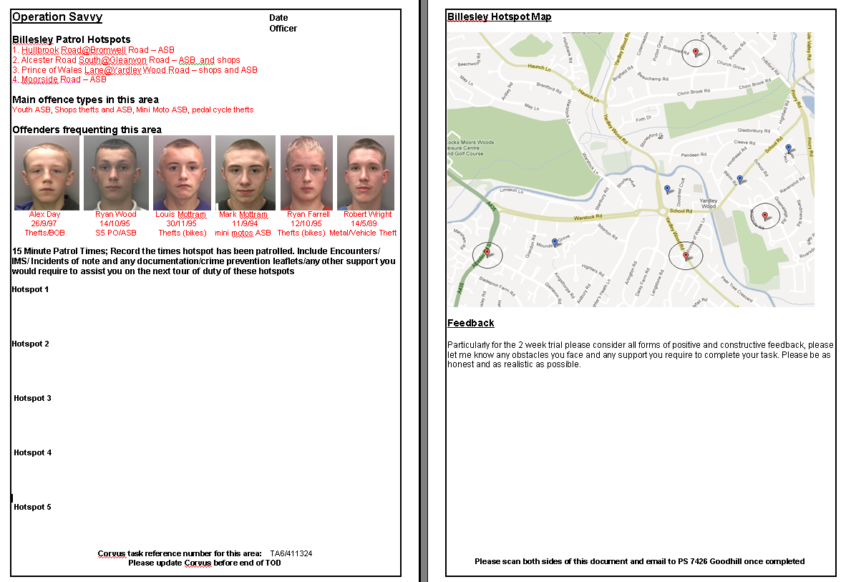
Tasking Sheet for each Patrol area (example)

Slide 18
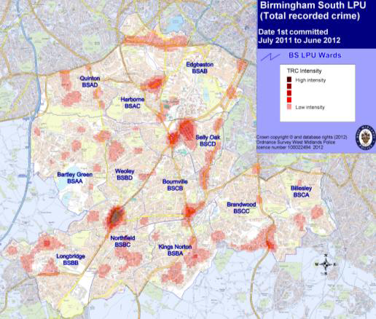
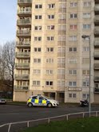
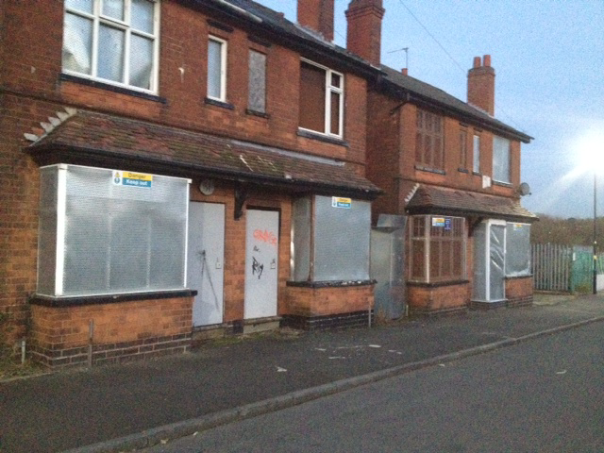
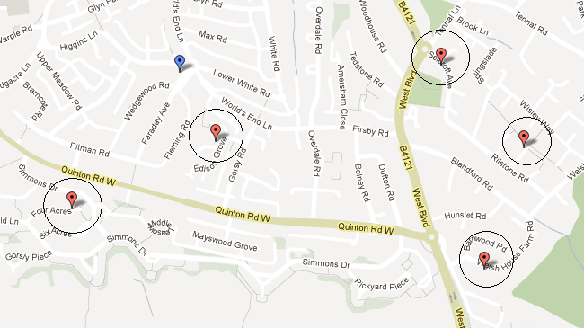

Slide 19
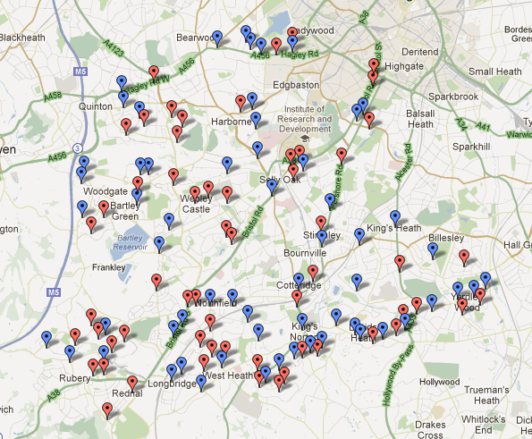

Slide 20
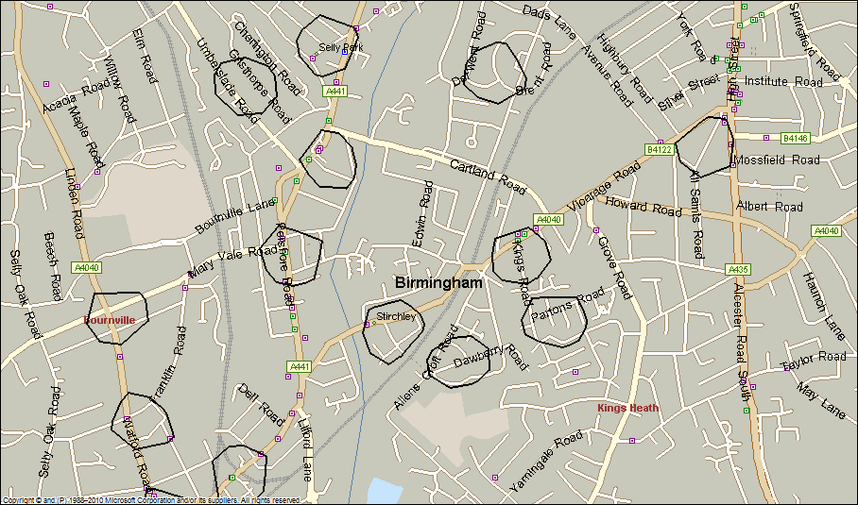

Slide 21
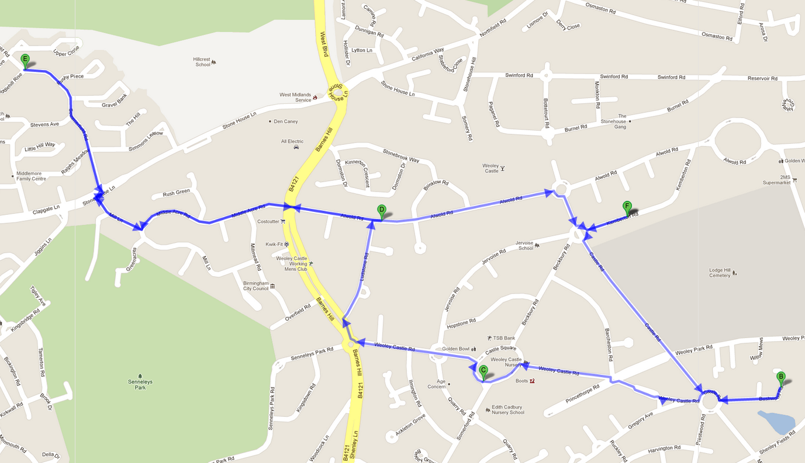
Patrol Example
BREAK 15 MINUTES
17:50-18:05
→1.4 miles; 27 minutes
start: 15:30-15:45
← 0.9 miles; 19 minutes
17:00-17:15
Restart 18:35-18:50
0.5 miles; 12 minutes
0.6 miles; 12 minutes
0.6 miles; 12 minutes
16:00-16:15
16:30-16:45
Notes: (a) the patrol sequence should be altered on a daily basis;
(b) conducted by solo or double PCSO patrols
(c) dedicated officers must NEVER proactively patrol the control areas – ?

Slide 22
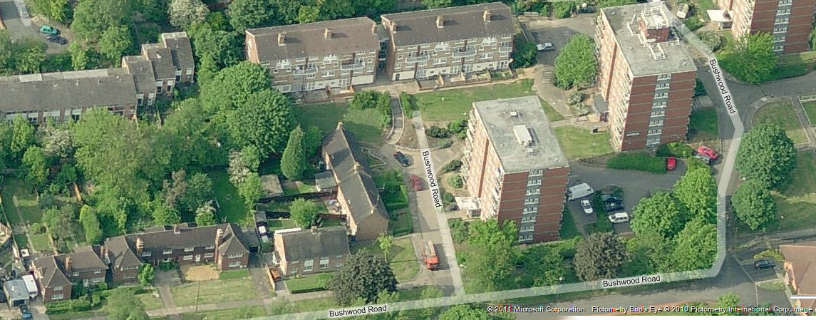

Slide 23
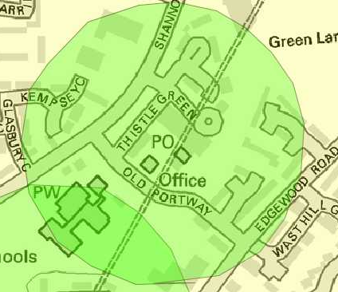
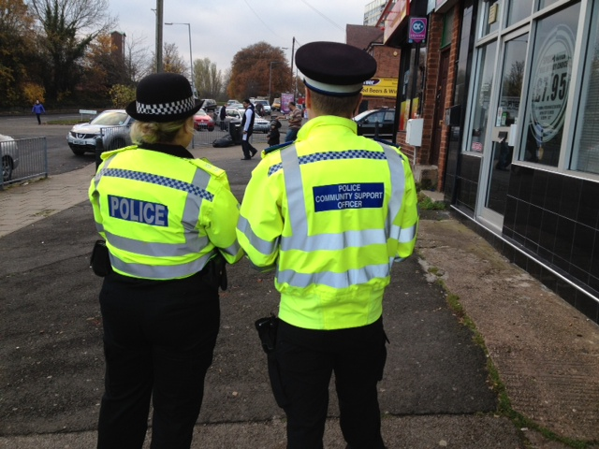
Preventative Patrol (1 of 2) “Car Wash”
Shannon Rd Car wash
Kings Norton Hotspot 2 – Cluster 36
Main offence types in this area
Youth ASB, BDH, Drugs, Damage

Slide 24
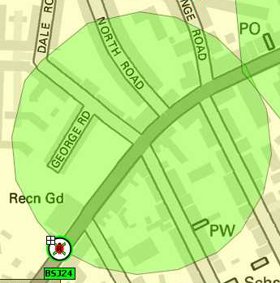
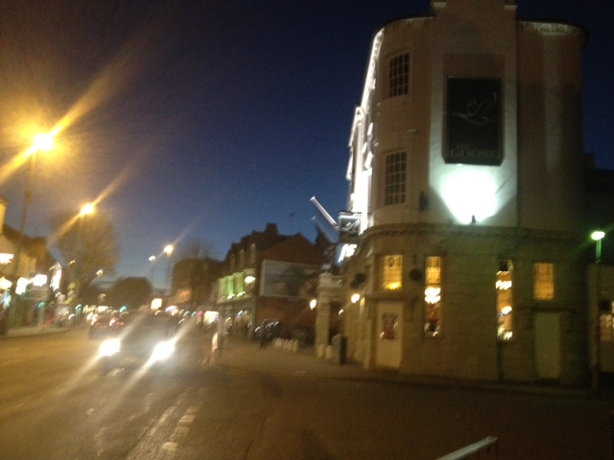
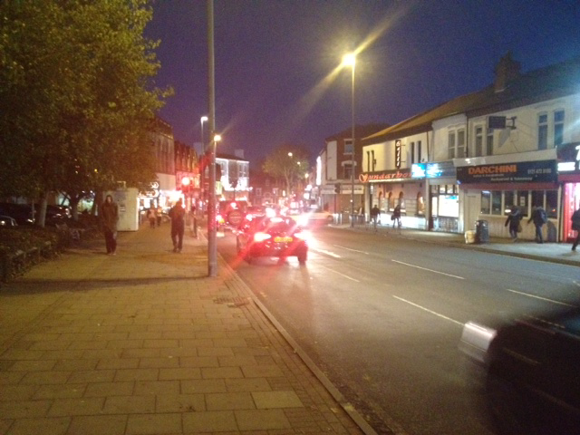
Preventative Patrol (2 of 2) “The Goose PH”
The Goose PH
Aldi
Selly Oak Hotspot 2 – Cluster 20
Main offence types in this area
Shops thefts, Pubs and associated ASB, Street Drinkers

Slide 25
Tracking Officers
ARLS Data Analysis

Slide 26
Automatic Resource Location System ARLS
GPS-enabled system
“Sits” on Airways Systems
Uses “Point in polygon” analysis
Locates officers everywhere
GPS-ping every 120 seconds

Slide 27
How Data are Captured?
Officers enter the geo-fenced area
Email notification with every PING
N emails = 683,069 over 135 days (23/11-06/04)
Convert outlook emails into txt file into excel file into SPSS

Slide 28
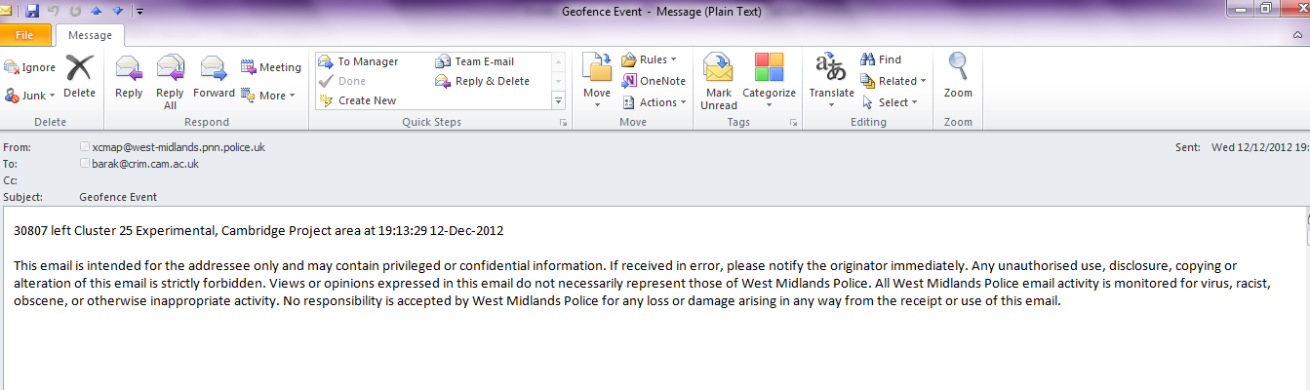
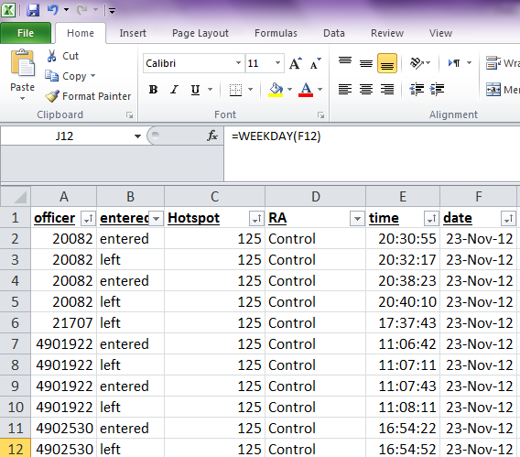

Slide 29
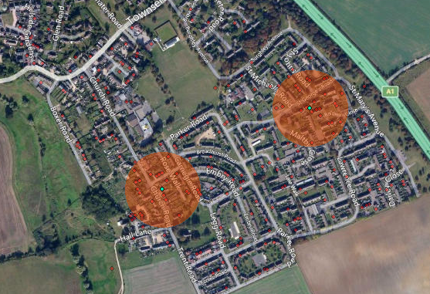
ARLS Findings

Slide 30
Hotspot as the Unit of ARLS Analysis

Slide 31
41% diff – PCSOs only
16% diff – all officers

Slide 33
PCSOs as the Unit of ARLS Analysis (or: tracking in the 21st century)

Slide 34
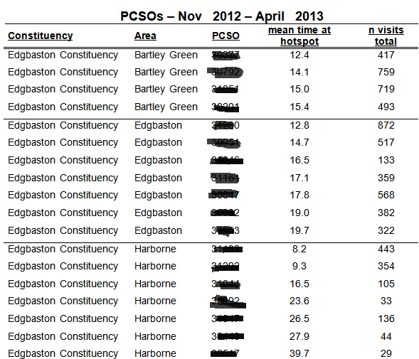

Slide 35

Managing Police Patrol Time
Communication
Training*
Front Line Supervisors*
Organisational Support (Reward)*
Time*
Senior Officer visibility
Accountability
* Based upon Famega, Frank and Mazerolle (2007) Managing Police Patrol Time: The Role of Supervisor Directives.

Slide 36
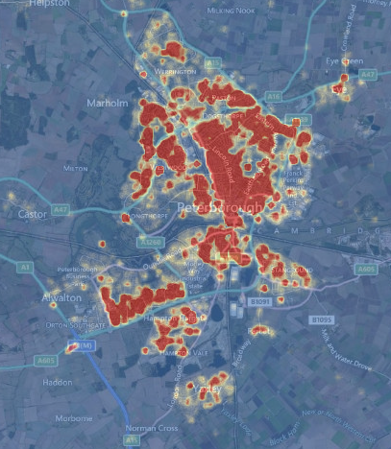
Operation Style

Slide 37

Unique Features
Chief Superintendent
Andy Hebb
10 year Longitudinal analysis
Non-crime outcomes (Quality of life measures)
GPS locators on all front line officers in LPU
72 Hotspots defined as:
Minimum calls for service in a hotspot within 48 months = 60
Maximum hotspot radius = 150 meters
Buffer zone/catchment area = 50 meters
Minimum distance between hotspot boundaries = 250 meters
“calls for service” = street incidents, no shopping arcades / schools / hospitals / leisure centre

Slide 38
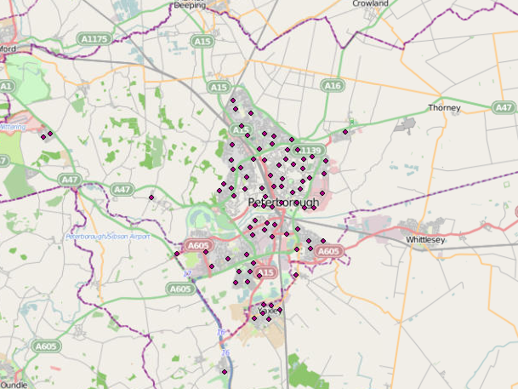
72 Hotspots developed from the offence data

Slide 39
Cont.
150 meter radius
Per hotspot
More than 250 meters between hotspots

Slide 40
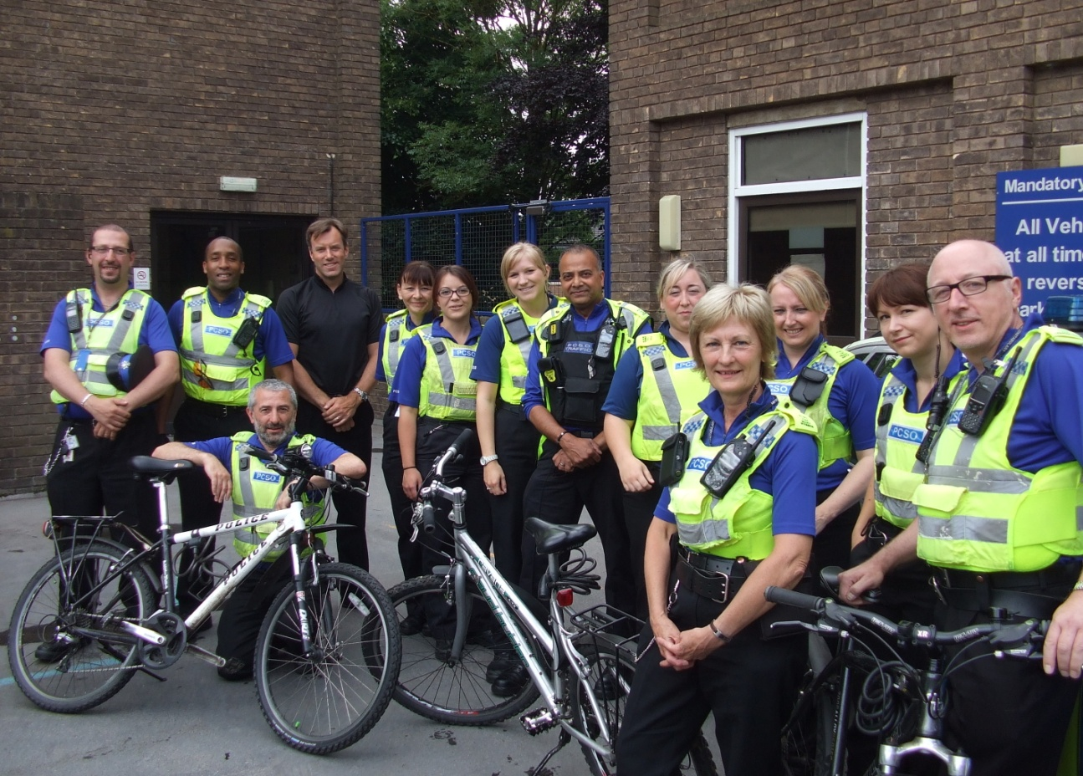
Community / PCSO Feedback

Slide 41
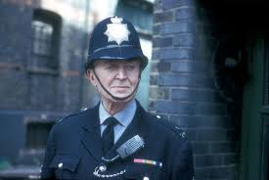

Impressions from the field
Good old fashioned policing
“Dixon of Dock Green”
Reflected in Confidence Surveys
Who is that strange PCSO in my area???!!

Slide 42
PCSO POSITIVE INTERVENTIONS 1
RIGHT PLACE, RIGHT TIME…..
Gladstone Hotspot – Drug deal intercepted – 2 Arrested
Paston Hotspot – Gang related assault. Serious injury averted – Suspects located. The stock of the PCSO goes up on area and with regular officers

Slide 43
PCSO POSITIVE INTERVENTIONS 2
Welland Hotspot – Two seen stealing fuel from cars – Arrested.
Intelligence submissions are increased in hotspot areas. This has enabled more focused long term activity / problem solving policing
Warm reception from the community….”
“Sir – This is fantastic. A member of the public offered me a cuppa as thanks for making them feel safe”

Slide 44
Non-Crime Outcomes

Slide 45
Non-crime outcomes in Peterborough 1 Quality of Life (QOL) Hotspots
Based on 12 months of data from Safer Peterborough Partnership - 86 QOL hotspots were identified
The total number of events* = 11,351
____
(*) sanitation, council / estate concerns, needles found, excessive noise, graffiti, etc.
Notes:
Is there a statistical relation between offences, QOL indicators and ambulance emergency calls in Peterborough?
QOL hotspots with 30 or more events each

Slide 46
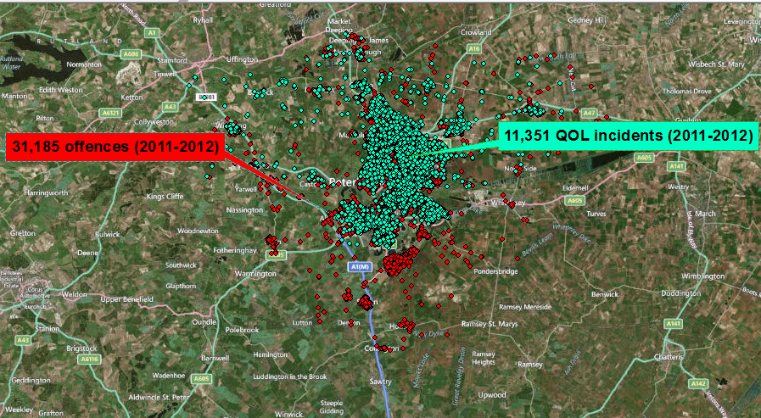
Offences and QOL events

Slide 47
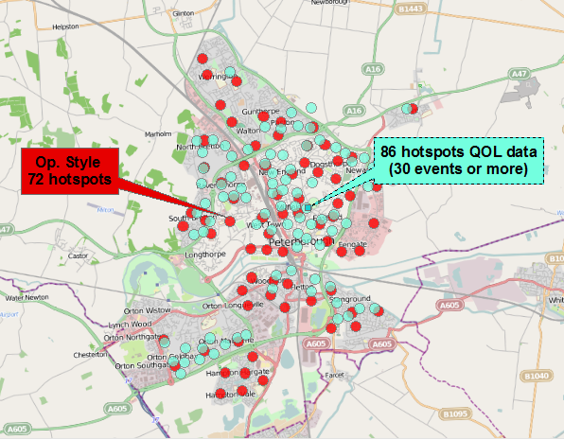
Offences and QOL hotspots overlapping
54.17% overlapping

Slide 48
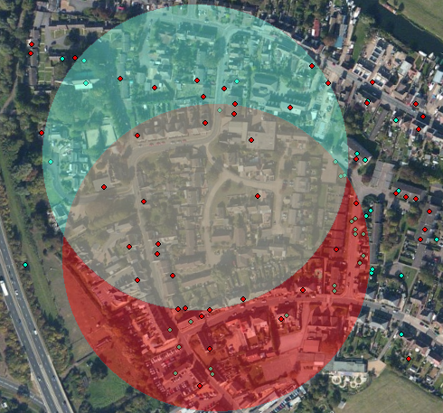
Overlapping example

Slide 49
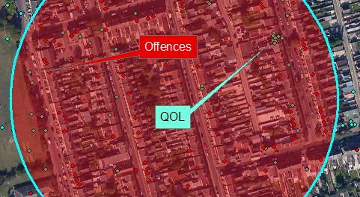
Spearman’s Rho = .754 (p<.001) → sharing 57% of variance
Offences and QOL hotspots spatial relation

Slide 50
VVV
Non-crime outcomes in Peterborough 2 Ambulance Hotspots
Digitised records of ambulance emergency calls for assaults from Peterborough (N=775), between April 01st 2011 and March 31st 2012 (provided by the East Ambulance Trust)
Hotspot methodology can be used to share data between agencies without disclosing personal information
Ariel, B., Weinborn, C., and Boyle, A. (forthcoming). “Can routinely collected ambulance data about assaults contribute to community violence reduction”

Slide 51
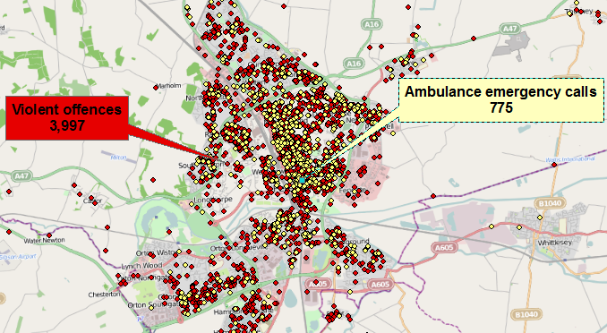
Violent offences and ambulance emergency calls
Notes:
Violent offenses police calls-for-service data, over the same period of time and from the same geographic boundaries were provided by Cambridgeshire Constabulary (N=3,997).

Slide 52
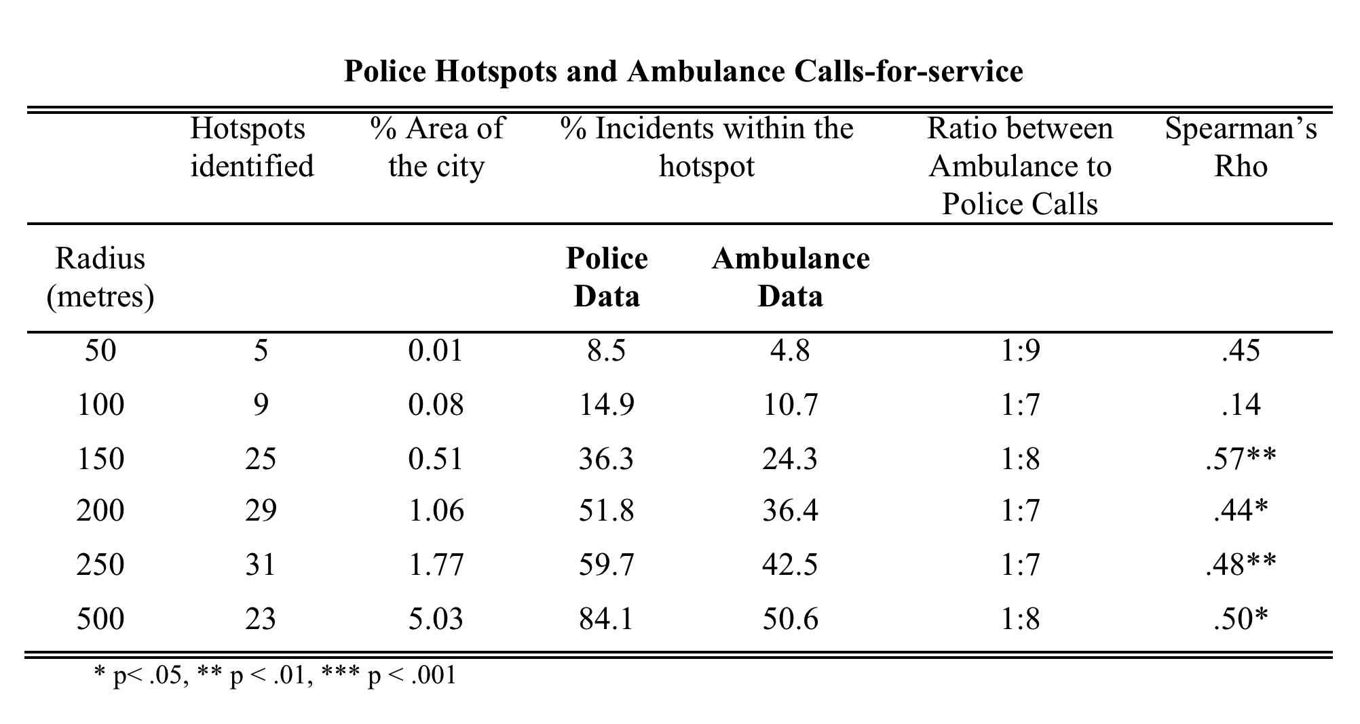
Violent offences and ambulance emergency calls spatial relations
Notes:
(1) The 1:8 calls for service ratio is consistant throughout, regardless of hotspot size; (2) in only 25 150-meter hotsopts one can find 50% of all police incidents and over a third of all ambulance calls for service. (3) however, only 50% of the hotspots overlap, and this suggests that there is room to share data

Slide 53
Peterborough GPS data

Slide 54
Notes:
When the time spent was weighted against the total number of hotspots per block the difference between the minutes spent by PCs in treatment and control areas was of 25% more in treatment areas (05:42 vs. 04:35), while in the case of PCSOs this difference was more than 100% higher. In other words, 10:53 in treatment clusters against 05:28 in control hotspots.

Slide 55
Notes:
When the time spent was weighted against the total number of hotspots per block the difference between the minutes spent by PCs in treatment and control areas was of only 2% more in treatment areas (40:39 vs. 39:40), while in the case of PCSOs this difference was more than 277% higher. In other words, 41:27 in treatment clusters against 10:59 in control hotspots.

Slide 56
Notes:
Overall results weighted by the number of hotspots within blocks (13,4 control hotspots and 10,9 experimental hotspots)

Slide 57
Notes:
Overall results weighted by the number of hotspots within blocks (2.3 control hotspots and 4.0 experimental hotspots) 2,3 4,0

Slide 58
Outcomes

Slide 59
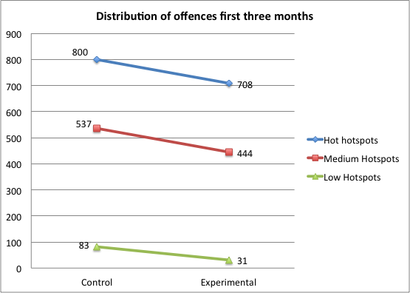
Peterborough – Post RA only
12%
25%
63%

Slide 60
Birmingham South 6 months before-after analysis

Slide 61
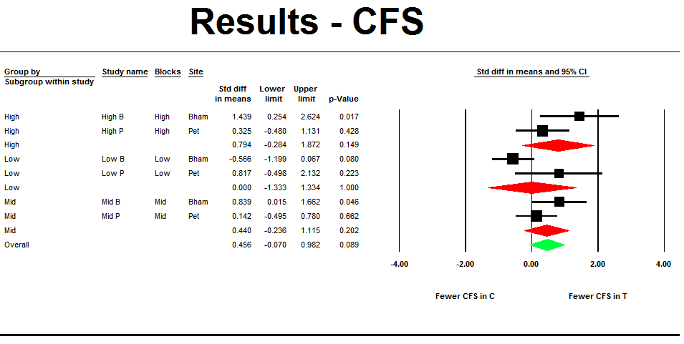

Slide 62
A Reversed Effect in Birmingham South Low level hotspots - What happened?

Slide 63
Three hypotheses
The “Suboptimal Dosage” hypothesis
The “Crime Reporting Behaviour” hypothesis
The “Oversized Hotspot” hypothesis

Slide 64
The Dosage Hypothesis
Birmingham:
small temporal deltas between T & C
39% additional PCSO time
Number of visits by PCs in C decreased
Peterborough:
5.5 times additional PCSO time
virtually no time spent in low level control hotspots by PCs (or PCSOs)

Slide 65
The Crime Reporting Hypothesis*
PCSO presence increases reporting in hotspots generally characterised with both low crime and limited police patrol
(*requires further investigation re source of call)

Slide 66
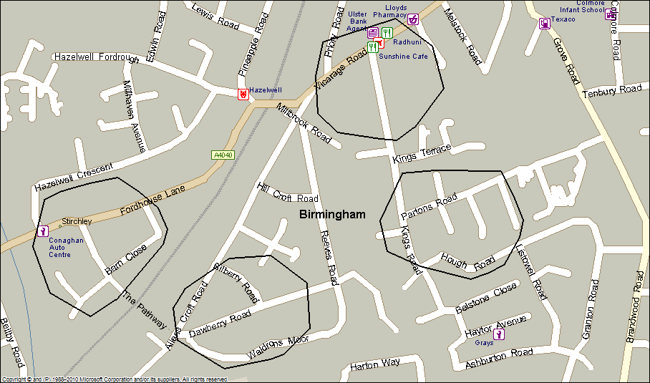
The Oversized Hotspot Hypothesis
Are 150m radius, low-level hotspots too big?
Birmingham South Peterborough

Slide 67
Conclusions / Policy Implications
Next 6-9 months of data will be revealing and hopefully with the new technology it will be easier to analyse
Deployment of PCSO patrols for short durations in high crime hotspots could be a cost effective patrol deployment
GPS locators will become critically important for management and accountability
Whilst this RCT has so far revealed similar results to other hotspot RCTs around the world, the GPS data allows us to ask more questions

Slide 68
The Birmingham and Peterborough PCSO Hot Spots Experiments Operation Savvy + Operation Style
6th International Conference on Evidence-Based Policing
Dr Barak Ariel
Neil Wain (PhD Cand.)
Cristobal Weinborn (PhD Cand.)
Sgt. Wendy Goodhill
Insp. Rob Hill
Prof Lawrence Sherman

